Slide 1
Management of the
Opioid dependent Patient
George Lederhaas,MD
Formally known as Lederhouse
Associated Anesthesiologists,PC
West Des Moines, IA

Slide 2
Opiate
An unlocked door in the prison of Identity. It leads into the jail yard.
Author, Ambrose Bierce
Written, 1900

Slide 3
Opioids
Pure agonist
  Oxycodone
  Morphine
  Fentanyl
  Hydrocodone
  Hydromorphone
Mixed agonist-antagonist
  Buprenorphine
Opioid agonist/NMDA antagonist
  Methadone

Slide 4
Associated Issues
Anxiety
Depression
Personality disorders
Polysubstance abuse
Diminished social support

Slide 5
Medication Assisted Treatment
Buprenorphine (SUBOXONE, BUTRANS, SUBUTEX)
  Oral, twice a day for MAT
  Transdermal, weekly for chronic pain
Methadone
  Oral, once a day for MAT
  Oral, TID to QID for chronic pain

Slide 6
Preoperative Management of MAT
For Buprenorphine, taper to 12 mg, 2-3 days before surgery
  Logistically easier to achieve than having taper off 3-5 days before surgery
  12 mg/day, only 75% mu receptor occupancy
For Methadone, maintain usual dosing
  For doses over 100 mg, baseline EKG to assess QT interval

Slide 7
Opioid Binding to Mu Receptor (Ki)
Codeine 734.2
Meperidine 450.1
Oxycodone 25.87
Methadone 3.378
Naloxone 1.518
Fentanyl 1.346
Hydromorphone 0.3654
Buprenorphine 0.2157
Sufentanil 0.1380

Slide 8
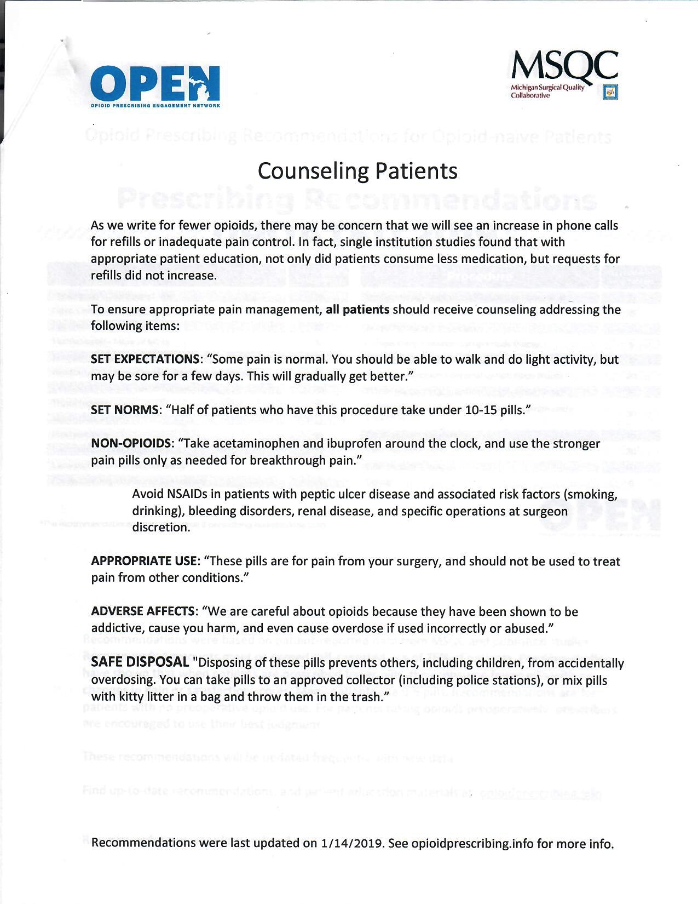
Preoperative Preparation

Slide 9
Multimodal Analgesia
NSAIDs/Acetaminophen
Local anesthetics
  Local infiltration, intravenous, regional blockade
Gabapentin
Ketamine
Dexamethasone
Tizanidine

Slide 10
NSAIDs
COX-2
  Celecoxib
Salicylic acid derivatives
  Coline magnesium trisalicylate, Diflunisal, Salsalate
Propionic acid derivatives
  Flurbiprofen, Ibuprofen, Ketoprofen, Naproxen, Oxaprozin
Acetic acid derivatives
  Diclofenac, Etodolac, Indomethacin, Ketorolac, Nabumetone, Sulindac, Tolmetin
Fenamates
  Meclofenamate
Oxicams
  Meloxicam, Piroxicam

Slide 11
Ketamine
NMDA antagonist
Can be taken orally, usually IV in perioperative setting
Acute antidepressant effects
Usually coadministered with Midazolam

Slide 12
Gabapentin
Voltage gated calcium channels
Oral preoperative administration
Analgesic benefit observed in breast and intra-abdominal surgery
Has anxiolytic properties (generalized and social anxiety)
Negligible respiratory depression

Slide 13
Tizanidine
Alpha 2 agonist
Oral bedtime administration
FDA approved for spasticity
Has sedative, anxiolytic properties
Can blunt autonomic activity during opioid tapering
Minimal respiratory depression compared to benzodiazepines

Slide 14
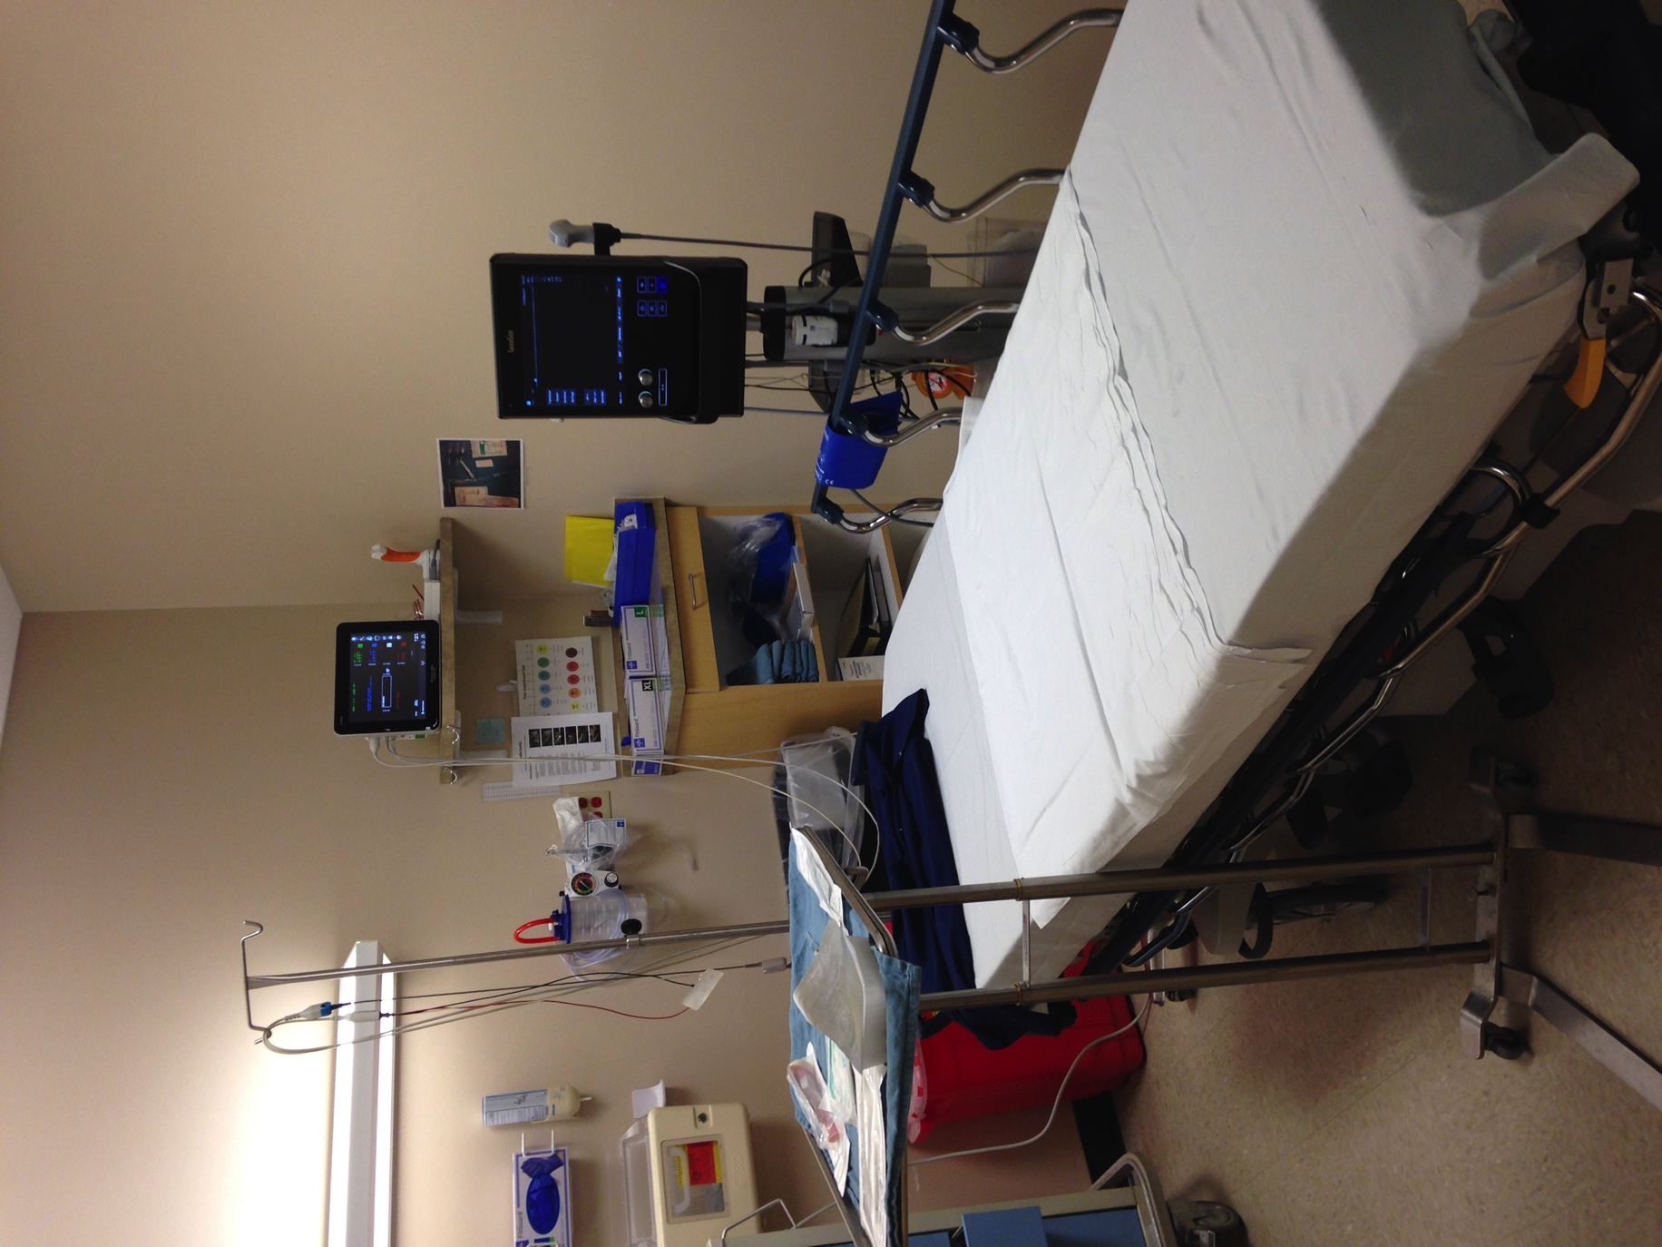
Regional Blockade

Slide 15
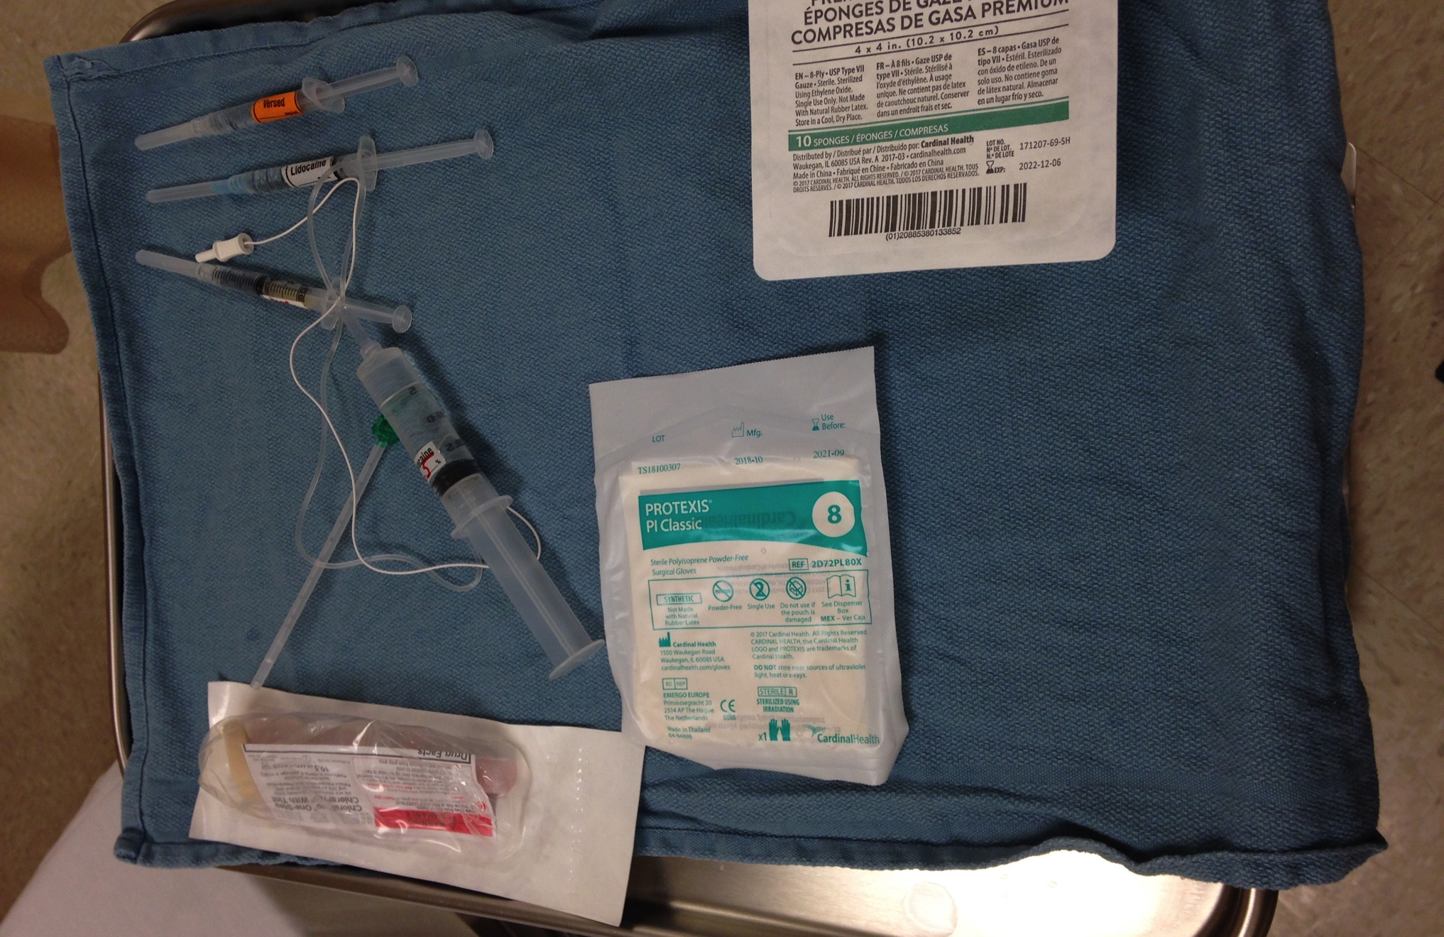
Setup

Slide 16
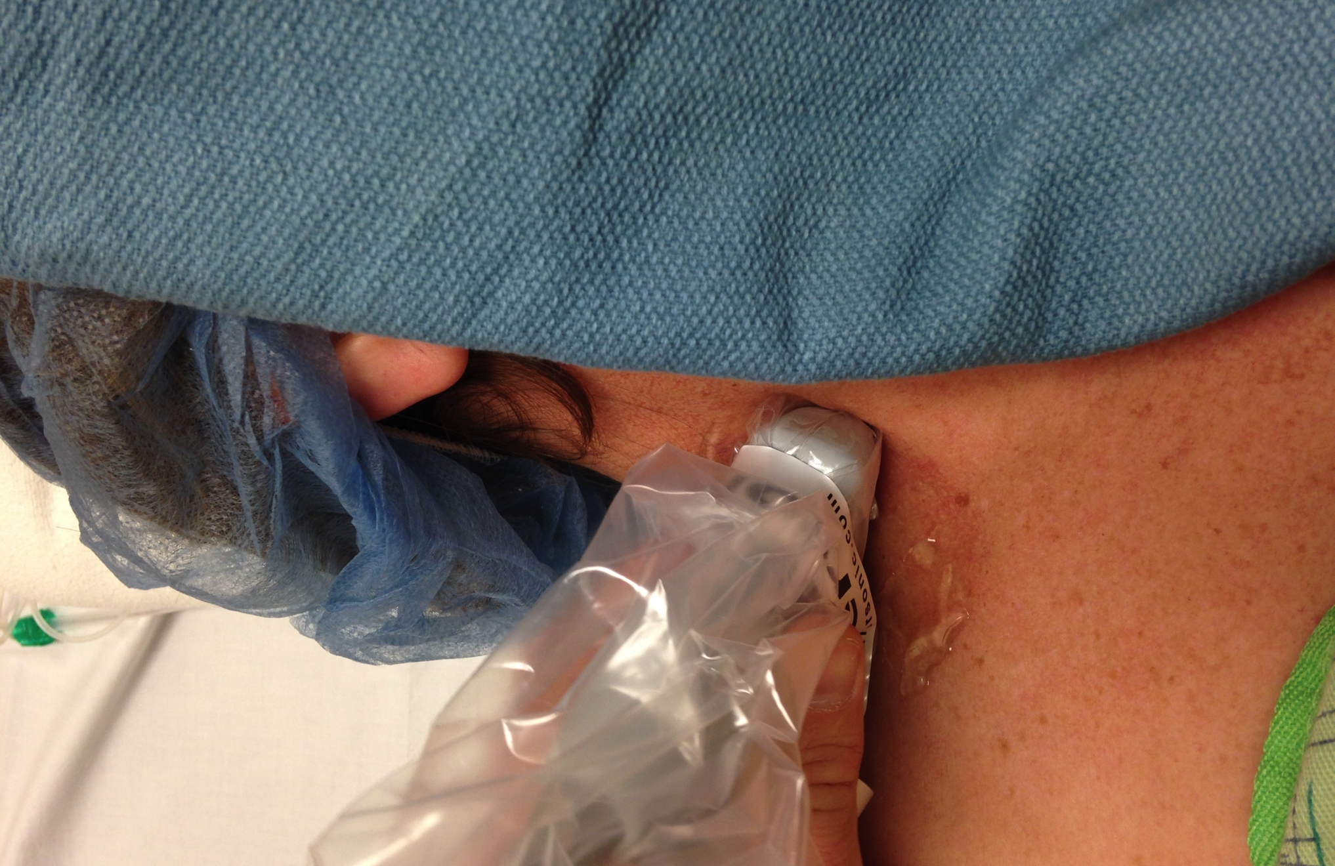
Interscalene Block

Slide 17
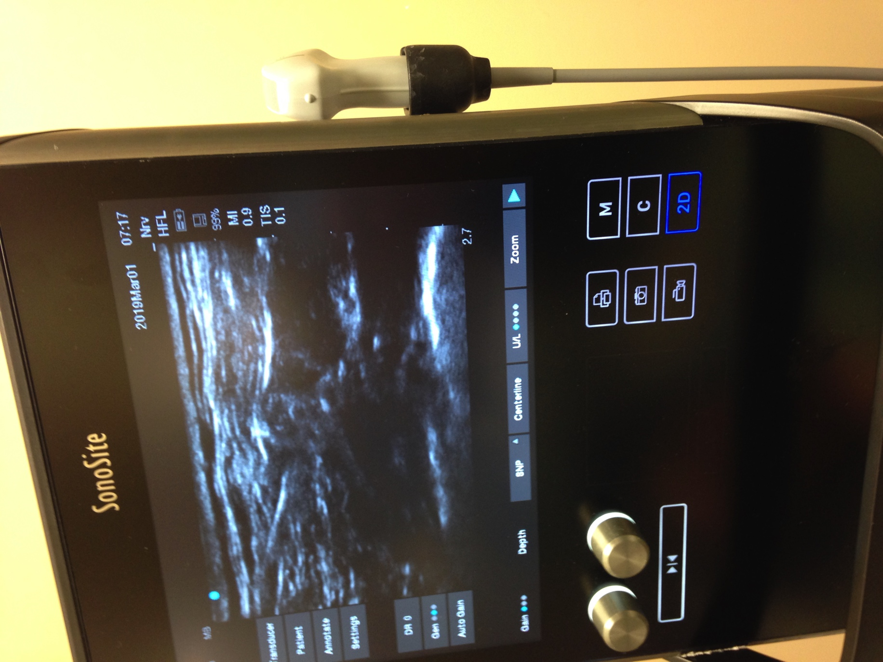

Slide 18
Summary
Clear game plan
Printed take home instructions
Responsible adult caregiver
Encouragement and Compassion

