Slide 1

Regional Anesthesia and
Local anesthetics
Shira Black, DO
Anesthesia & Analgesia
Quad Cities, Iowa

Slide 2
Peripheral Nerve Blocks and Regional Anesthesia
A local anesthetic nerve block is a short-term block involving injection close to the nerve for pain relief.
The local anesthetic bathes the nerve, numbing the area of the body that is innervated by that nerve.
The goal is to prevent pain by halting the transmission of signals from the painful site.
Some advantages of nerve blocks over solely general anesthesia include faster recovery and decreased postoperative pain.
Notes:
QuickStarter has created an outline to help you get started on your presentation. Some slides include information here in the notes to provide additional topics for you to research.

Slide 3

Contents,
Goals & Objectives
Local Anesthetics
  Mechanism of action
  Hypersensitivity and Toxicity
Nerve anatomy & injury
Common local anesthetics and adjuvants
Block equipment
Upper extremity nerve blocks
Lower extremity nerve blocks
Side effects and benefits of blocks

Slide 4


History of Local Anesthetics
The Incas regarded coca as a gift from the son of the sun God
Local anesthesia was accomplished by having the operator chew coca leaves and apply the macerated pulp to the skin and wound edges while using a knife to bore through the bone
Cocaine was brought back to Vienna by an explorer/physician named Scherzer.
In Vienna, the chemist Albert Niemann isolated and crystallized pure cocaine hydrochloride in 1860.

Slide 5
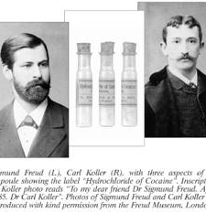
History of Local Anesthetics
Sigmund Freud was the most prominent of these cocaine experimenters.
Freud and Carl Koller (an ophthalmology trainee) took cocaine orally and noticed that the drug rendered their tongues insensible.

Slide 6

History of Local Anesthetics
The birth of local and regional anesthesia dates from 1884, when Koller and Gartner reported their success at producing topical cocaine anesthesia of the eye in the frog, rabbit, dog, and human.
The use of local anesthesia quickly spread around the world.

Slide 7


History of Local Anesthetics
William Halsted at Roosevelt Hospital in New York reported using cocaine to produce mandibular nerve block in 1884 and to produce brachial plexus block less than a year later.
Spinal anesthesia with cocaine was first accomplished in 1898 by August Bier. Cocaine spinal anesthesia was used to treat cancer pain in 1898.

Slide 8

History of Local Anesthetics
1902 Caudal epidural anesthesia by Sicard and Cathelin.
1909 Bier described intravenous regional anesthesia.
1911 Hirschel reported first 3 percutaneous brachial plexus anesthetics.
1921 Fidel Pages used epidural anesthesia for abdominal surgery.
Cocaine soon incorporated into many other products, including Coca-Colas original formulation devised by Pemberton in 1886.

Slide 9
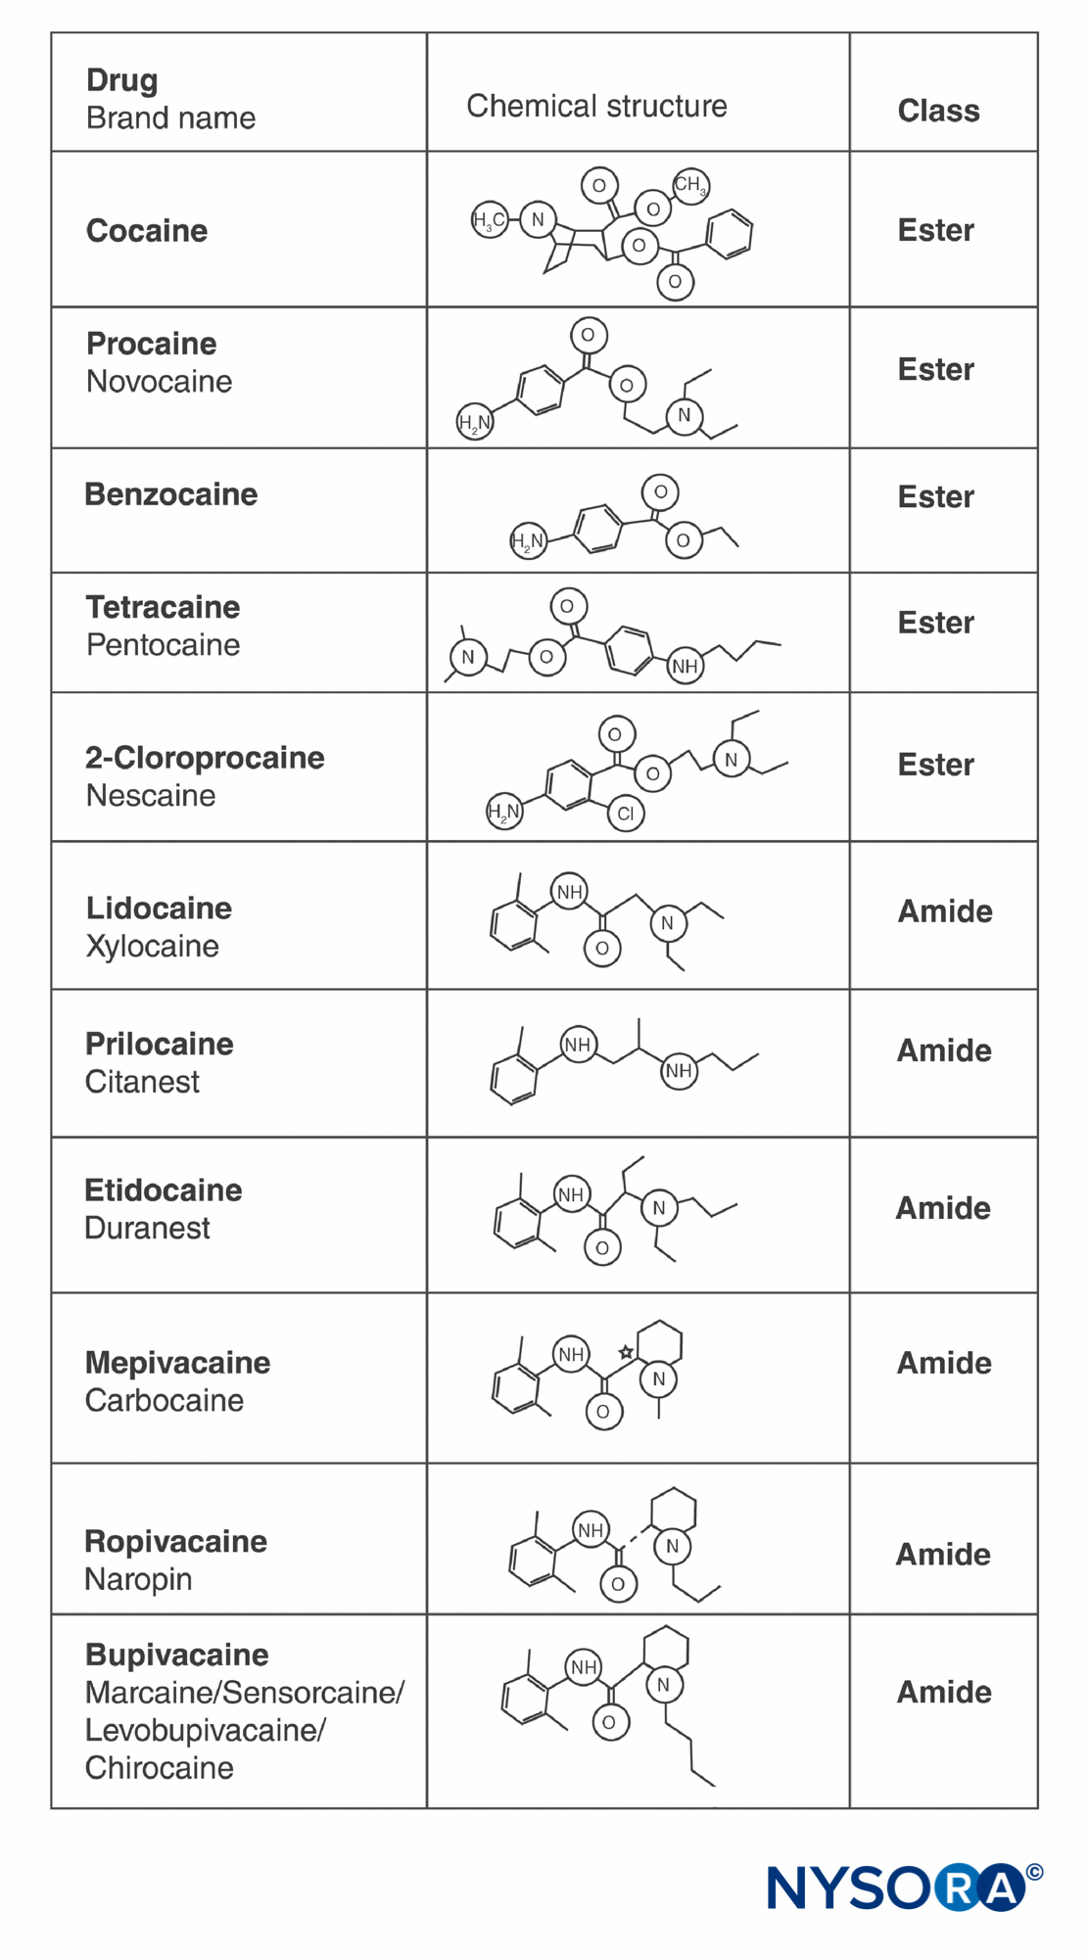
Local Anesthetic Chemistry
Cocaine and all other local anesthetics (LA) contain an aromatic ring and an amine at opposite ends of the molecule, separated by a hydrocarbon chain, and either an ester or an amide bond.
Cocaine, the archetypical ester, is the only naturally occurring LA.
Procaine, the first synthetic ester LA, was introduced in 1904 by Einhorn.
The introduction of the amide LA lidocaine in 1948 was transformative. Lidocaine quickly became used for all forms of regional anesthesia.

Slide 10
Allergic Reactions to Local Anesthetics
Ester local anesthetics are associated with a higher incidence of allergic reactions due to one of their metabolites, para-amino benzoic acid (PABA).
PABA is structurally similar to methylparaben.
Amide local anesthetics do not undergo metabolism to PABA, and therefore hypersensitivity to amide local anesthetics is rare.
Preservatives - Antioxidants (sodium bisulfite, metabisulfite) are added to local anesthetic products that contain vasoconstrictors to prevent biodegradation by oxygen.
Some patients may also be allergic to sulfites, and for this reason antioxidants should be avoided.
It is rare that a patient would be allergic to both an ester and amide local anesthetic.
Copyright © 2000-2018 The Cleveland Clinic Foundation. All Rights Reserved.
Center for Continuing Education | 1950 Richmond Road, TR204, Lyndhurst, OH 44124

Slide 11
Guidelines
If the patient is allergic:
to ester local anesthetics, try an amide local anesthetic.
to amide local anesthetics, try an ester local anesthetic.
to methylparaben or is allergic to both amide and ester local anesthetics, try a MPF product.
to antioxidants or sulfite compounds, review the product ingredients with the Department of Pharmacy.
Copyright © 2000-2018 The Cleveland Clinic Foundation. All Rights Reserved.
Center for Continuing Education | 1950 Richmond Road, TR204, Lyndhurst, OH 44124

Slide 12
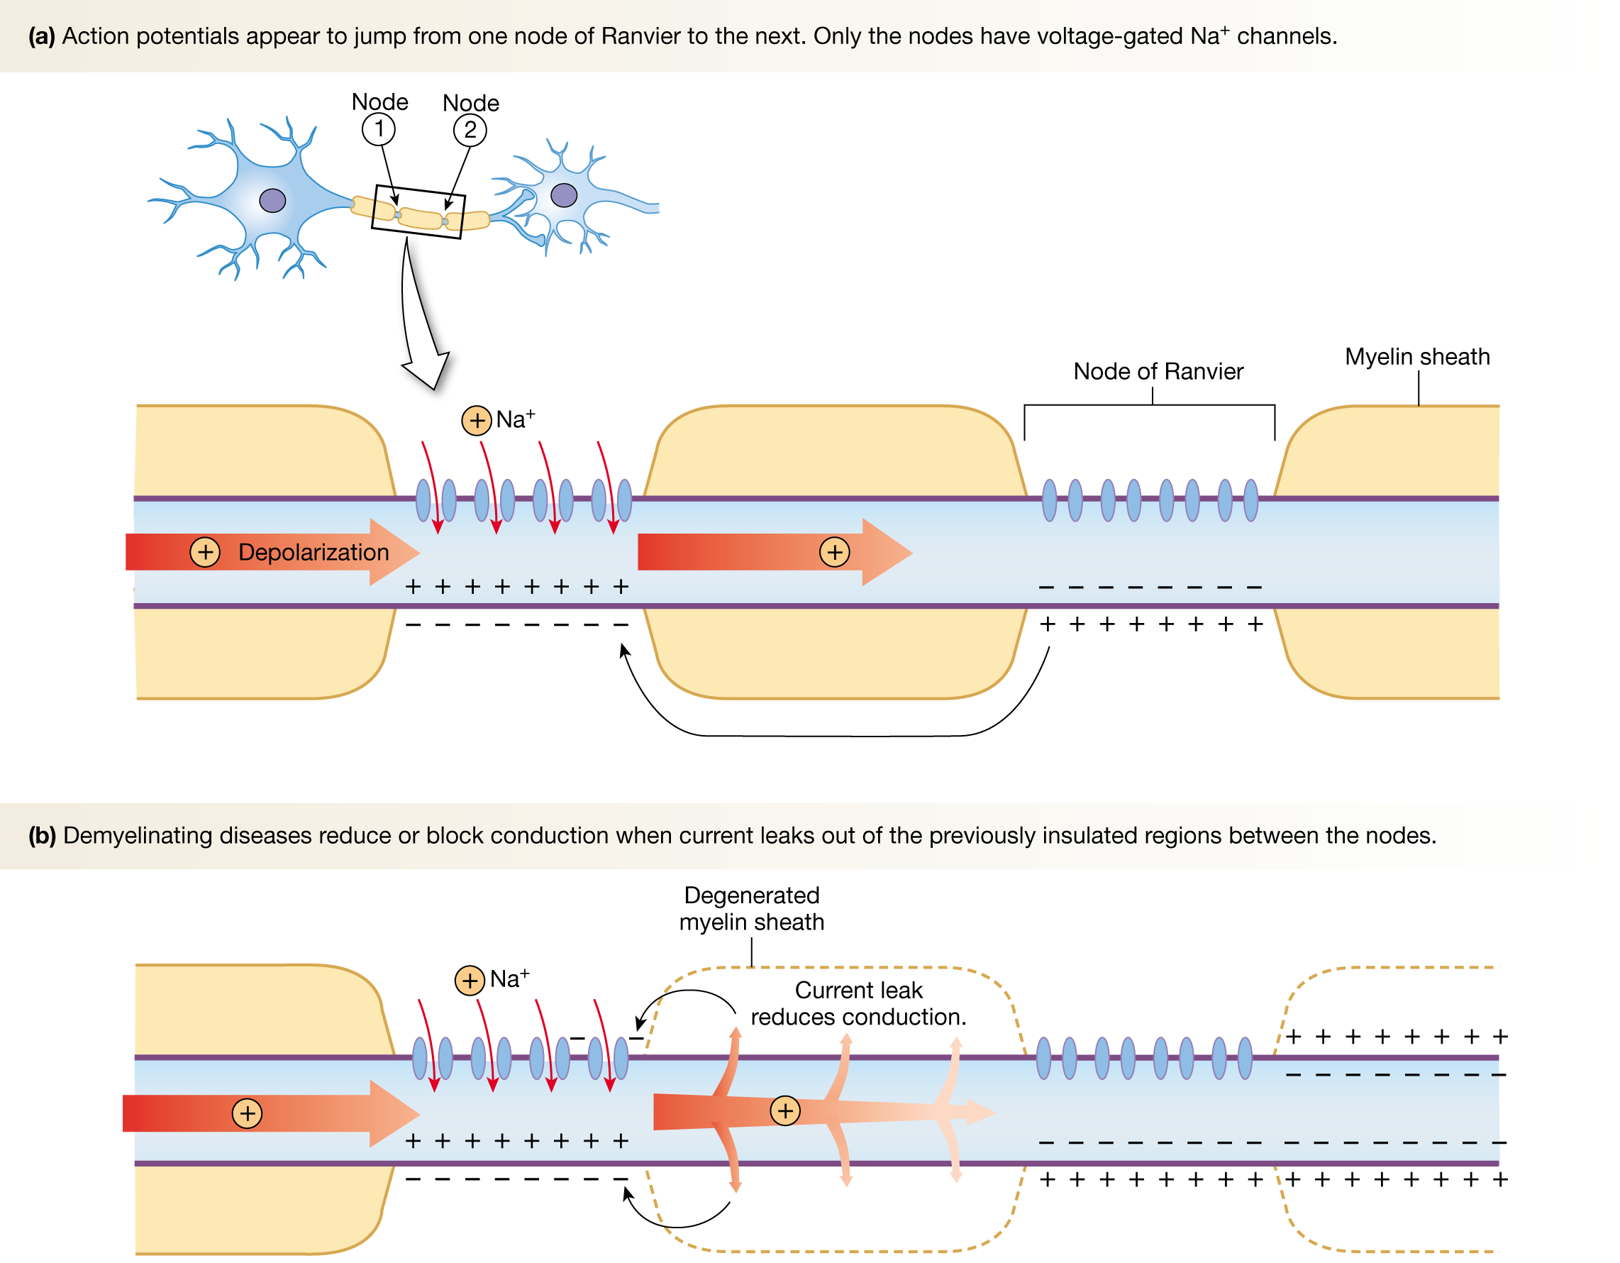
Mechanism of action
Local Anesthetics work on the Pain Nerve Afferent Fibers

Slide 13
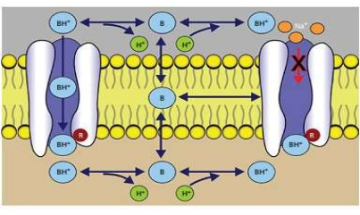
Mechanism of action
Local anesthetics block nerve conduction by inhibiting the influx of Na+ ions through the ion specific sodium channels in nerve membranes.
This leads to the impairment of generation and conduction of action potentials.
Nerve impulses are stopped and the brain therefore doesn’t sense the pain.

Slide 14
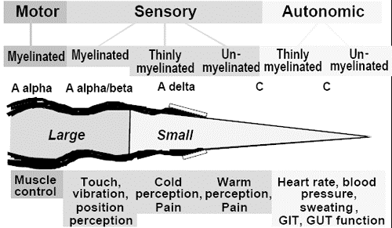
Local Anesthetic Affect
Local Anesthetics work on every nerve
General Rule: work on smaller nerve fibers more readily than LARGE
Also myelinated fibers are more susceptible than non-myelinated
This means for us:
Nociceptor (Pain Fibers)
Sympathetic
Temperature
Motor

Slide 15

Pharmacology
Local Anesthetics are Weak Bases pKa 8-9
  Non-Ionized (B)
  Can Penetrate Cell Membrane
When in the physiological pH ~7
  Weak base goes into it’s ionized form (BH⁺)
  Cannot penetrate the cell Membrane
This makes sense - as in cases of infection or ischemic tissue
  Tissue pH is even lower as lactic acid collects
  Local anesthetics are not very effective in areas of abscess because they can’t enter the nerve cell

Slide 16
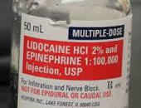
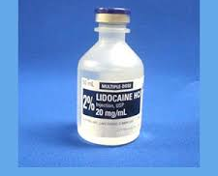
Local anesthetic solutions
For the local anesthetic base to be stable in solution, it is formulated as a hydrochloride salt.
This is an acidic solution.
Formulations with epinephrine are even more acidic.
The molecules exist in a quaternary, water-soluble state at the time of injection.
However, this form will not penetrate the neuron.
The time for onset of local anesthesia is therefore predicated on the proportion of molecules that convert to the tertiary, lipid-soluble structure when exposed to physiologic pH (7.4).
By definition, the pKa of a molecule represents the pH at which 50% of the molecules exist in the lipid-soluble tertiary form and 50% in the quaternary, water-soluble form.
Dosing? How many mg per ml of local? Of Epi?

Slide 17
Local anesthetic solutions
The acidic environment associated with inflamed tissues favors the quaternary, water-soluble configuration even further.
This accounts for difficulty when attempting to anesthetize inflamed or infected tissues; fewer molecules exist as tertiary lipid-soluble forms that can penetrate nerves.
In these situations, bupivacaine (pKa 8.1) would be least effective and mepivacaine (pKa 7.6) would be most likely to provide effective anesthesia.
________________________________________
Bottom Line – higher pKa, slower onset

Slide 18
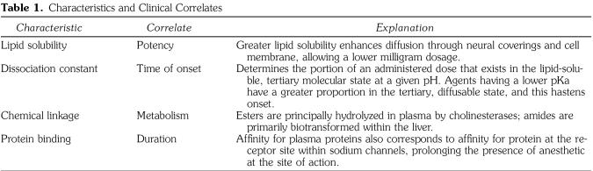
Characteristics and Clinical Correlates
Increasing molecular size, increased lipid solubility and potency.
Bupivacaine and Etidocaine are highly lipid soluble, therefore less water soluble, and more protein bound.
This means they are less readily removed by the blood stream and will take longer to “washout.”
Becker DE, Reed KL. Essentials of local anesthetic pharmacology. Anesth Prog. 2006;53(3):98–110. doi:10.2344/0003-3006(2006)53[98:EOLAP]2.0.CO;2

Slide 19
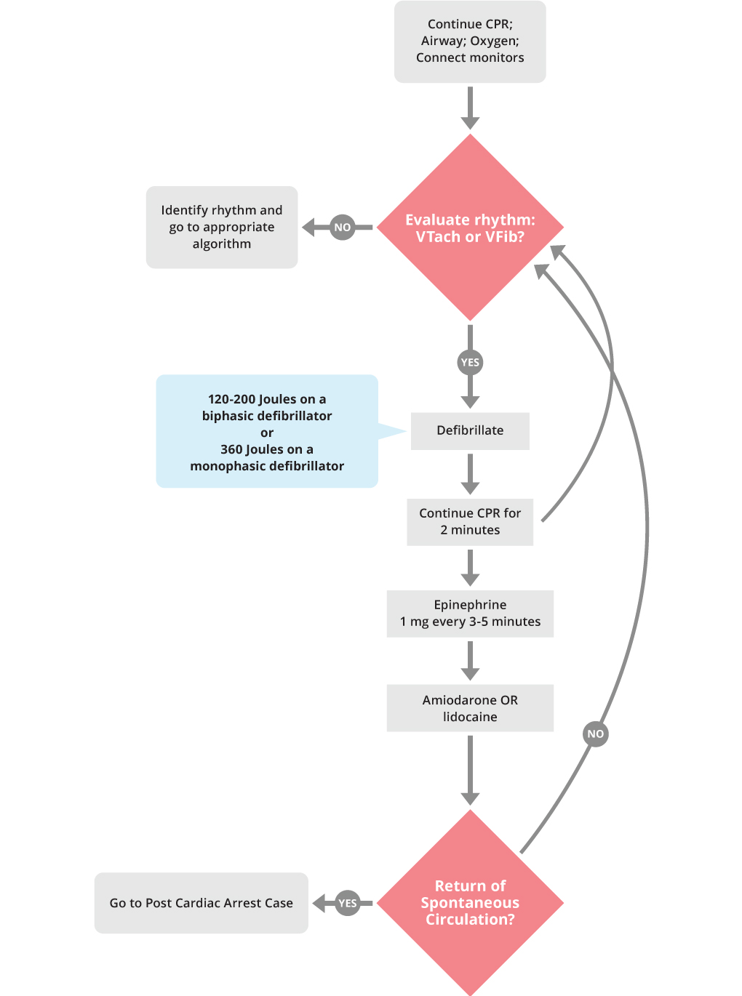
Common local anesthetics and adjuvants
Lidocaine
  Rapid Induction, Medium Duration, Good Tissue Penetration
  Very commonly use
  Anti-Arrhythmic (Category 1B)
    Slows ventricular excitation
    Used for V-tach
Bupivacaine
  Slow Induction, LONG Duration, Medium Tissue Penetration
  BURNS!
  Commonly used for longer procedures
  High myocardial toxicity

Slide 20
The Ideal Local
Regional anesthesia and pain management would be transformed by a LA that would selectively inhibit pain transmission while leaving other functions intact.
However, sensory anesthesia sufficient for skin incision usually cannot be obtained without motor impairment.
Bupivacaine and ropivacaine are relatively selective for sensory fibers.
Whereas the closely related chemical mepivacaine demonstrates no differential onset during median nerve blocks

Slide 21
Sensory order of Block
Pain
Cold
Warmth
Touch
Deep Pressure
Motor

Slide 22
What else influences local anesthetic activity?
Many factors influence the ability of a given LA to produce adequate regional anesthesia:
Dose
  higher, increases success and duration
Site of administration
  fastest onset and shortest duration of anesthesia occur with spinal or subcutaneous injections
  slower onset and longer duration are obtained with plexus blocks.
Additives
  Epinephrine, clonidine, NaHCO3, opioids, dexamethasone, and hyaluronidase.
Temperature
Pregnancy
  Both protein binding and protein concentration decline
Liposomal formulations → Exparel

Slide 23
5 Main Techniques
Topical
Infiltration
Conduction
Extradural
Spinal

Slide 24
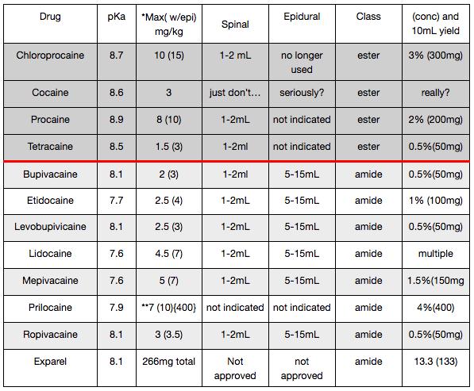
Blood Concentrations
Peak concentrations vary by the site of injection.
With the same dose, intercostal blocks consistently produce greater peak concentrations than epidural or plexus blocks.
As has been recently discussed by others, it makes little sense to speak of “maximal” doses of LAs except in reference to a specific nerve block procedure, since peak blood levels vary widely by block site.
© 2018 | Twin Oaks Anesthesia Services, LLC

Slide 25
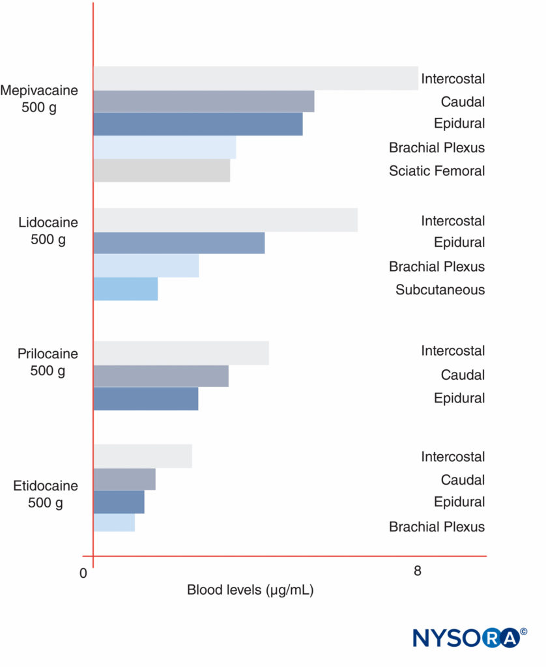
Blood Concentrations

Slide 26
Side Effects and Toxicity
Headache
Dizziness
Tinnitus
Confusion
Convulsions
CNS Depression/Coma
Respiratory Depression
Myocardial Depression/Vasodilation
Local Anesthetics depress the CNS in a dose dependent manner
Convulsive seizures are the principal life-threatening consequence of local anesthetic overdose.
  Presumably this is due to selective depression of central inhibitory tracts, which allows excitatory tracts to run amuck.
This differs from Cocaine
  Not a CNS Depressant
  Actually a CNS Stimulant
  Only local anesthetic with vasoconstrictive properties
Prilocaine
  Methemoglobinemia due to metabolite 0-toluidine
  Contraindication for someone with hereditary methemoglobinemia

Slide 27
Treatment of Local Anesthetic Toxicity
Treatment of adverse reactions depends on their severity.
Minor reactions can be allowed to terminate spontaneously.
Seizures induced by LAs should be managed by maintaining a patent airway and by providing oxygen. May also administer:
  midazolam (0.05–0.10 mg/kg)
  propofol (0.5–1.5 mg/kg)
  succinylcholine (0.5–1 mg/kg), followed by ventilation
Cardiovascular depression manifested by hypotension, may be treated by infusion of intravenous fluids and vasopressors
  phenylephrine 0.5–5 μg/kg/min
  norepinephrine 0.02–0.2 μg/kg/min
  vasopressin 40 μg IV
  epinephrine (1–5 μg/kg IV bolus) if myocardial failure is present
When toxicity progresses to cardiac arrest, the guidelines for treatment of LA toxicity as developed by the American Society of Regional Anesthesia and Pain Medicine (ASRA) are used.

Slide 29
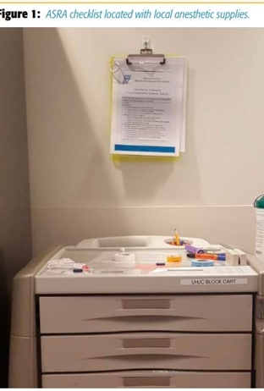
Scenario of Local Anesthetic Toxicity
At the conclusion of a busy day at your free-standing ambulatory surgery center, you are transporting your last patient to the recovery room following repair of their anterior cruciate ligament. Thirty minutes into his recovery, the patient continues to complain of 10/10 anterior knee pain, despite intravenous opioids. As the recovery room is starting to empty out and your colleagues head for home, you decide to proceed with an adductor canal block with ropivacaine for analgesic purposes. Five minutes after completing the block, you notice tachycardia, hypertension, and frequent premature ventricular contractions. Your mind immediately jumps to the possibility of local anesthetic systemic toxicity (LAST). As the patient begins to seize, you instantly take action by notifying the nurse, requesting help, and asking for midazolam, lipid emulsion, and airway equipment. The nursing staff is able to recognize the concern in your voice, but they report that you are the only anesthesia provider left in the building and give you a puzzled look at the request for lipids. As you are able to gather the resources to successfully manage the situation, you ponder how prepared your ASC is to manage a case of LAST.
In response to simulations sessions an important question was posed:
How much lipid emulsion should we have available to be adequately prepared to appropriately treat a patient while awaiting transfer?

Slide 30
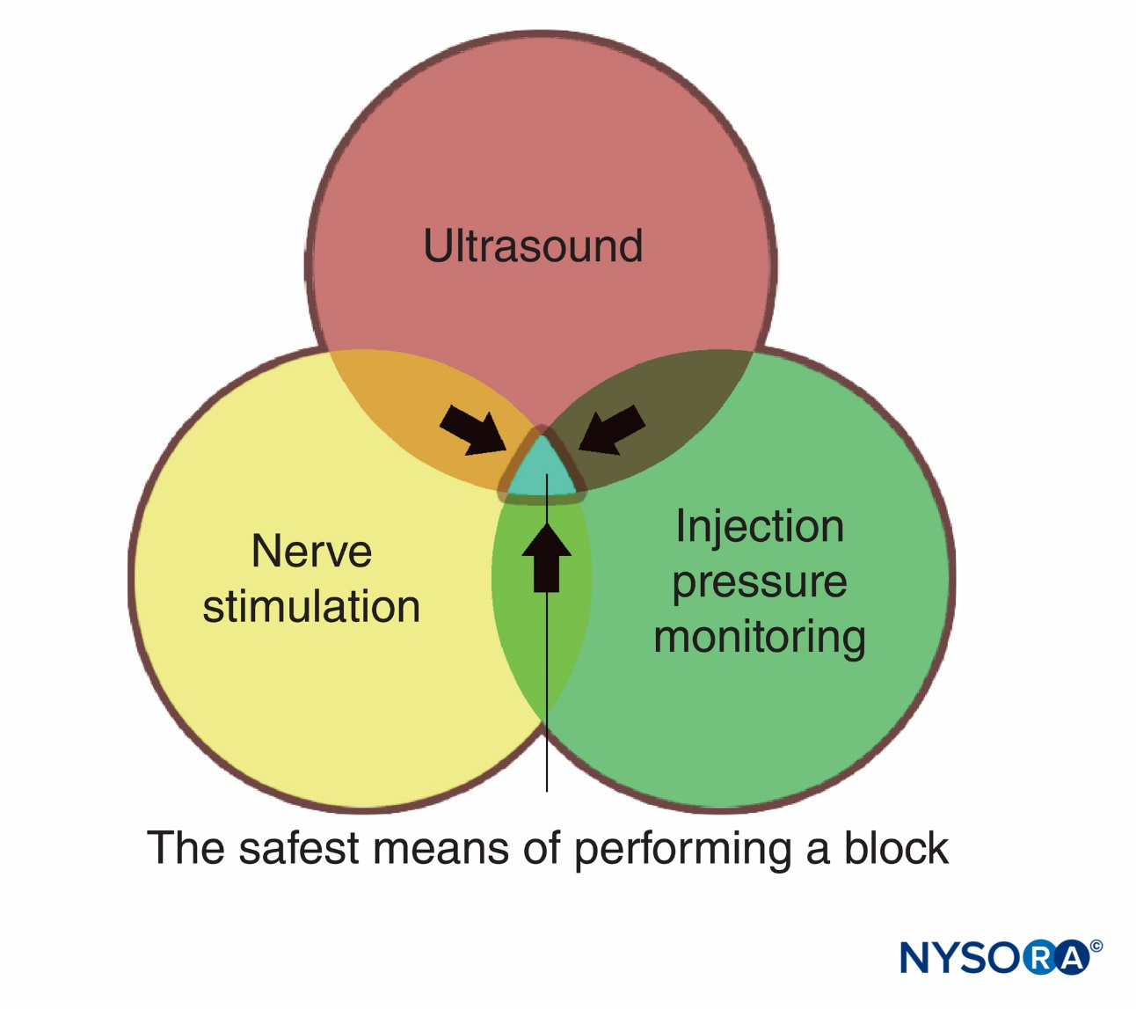
Monitoring for Nerve Blocks
Monitors in the medical practice assess specific physiologic data and warn the clinician of impending harm. (We’re talking about monitoring for nerve damage and safe blocks)
For Nerve Blocks, options include: stimulation, ultrasonography, and injection pressure.
Each has its own distinct set of both advantages and limitations and each is best used in an additive, complementary fashion to minimize the potential for patient injury.
Nerve Stimulator: When local anesthetic was injected at currents between 0.3 and 0.5 mA, the resulting nerve tissue showed no signs of an inflammatory process, whereas injections at less than 0.2 mA resulted in lymphocytic and granulocytic infiltration in 50% of the nerves.
Ultrasound: revolutionized the practice of regional anesthesia and allowed a substantial evolution of the subspecialty from an art practiced by a few to a science that is more reproducible.
Injection Pressure: When the pressure in the system approaches 15 psi without the ability to commence flow of injectate, this high opening injection pressure may signal a dangerous needle-nerve relationship or needle placement in wrong tissue plane. Therefore, the injection should be halted and needle position reevaluated.

Slide 31
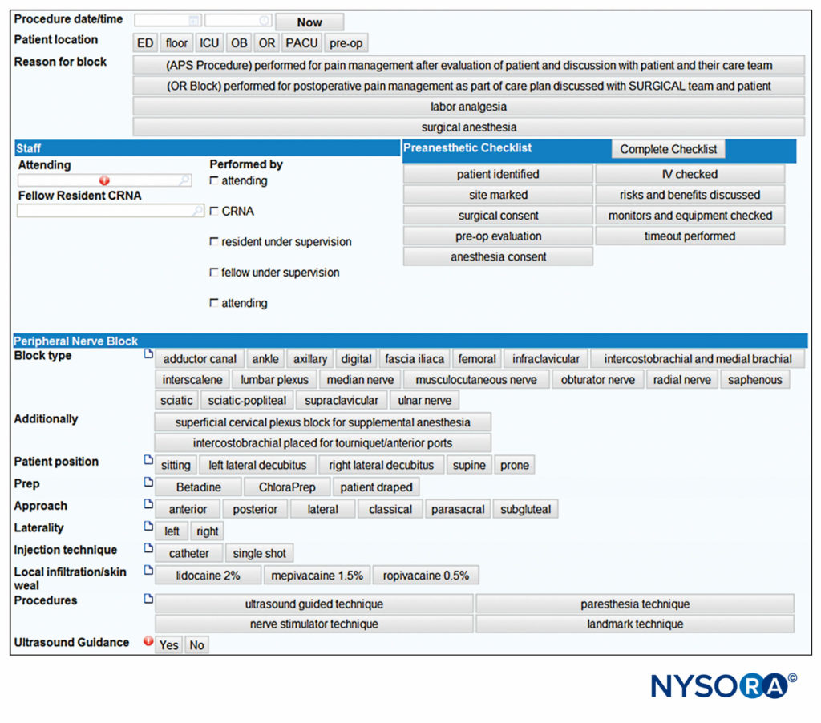
Documentation and Consent
Useful Features of a Peripheral Nerve Block Procedure Note | Example
Elements that guide the practitioner to meet a given standard of care | A space to indicate the use of epinephrine in the local anesthetic solution or if none was used, why not
A compromise between efficiency and ability to individualize | Information recorded using both tick boxes and blank line spaces
Documentation to safeguard against common medicolegal challenges | Practitioner must indicate patient’s level of consciousness
Documentation of compliance with regulatory agencies (ex. Joint Commission) | Tick boxes indicate laterality
Elements to facilitate successful billing | Language required by many insurance companies indicating block specifically requested by surgeon
Documentation of clinicians involved and in what capacity | Was the attending the individual performing the block, or was he or she medically directing a resident?

Slide 32
Consent
Documentation of informed consent is an important aspect of regional anesthesia practice.
Practice patterns vary widely on this issue, and specific written consent for nerve block procedures is often not obtained.
However, one may consider it important:
  Patients are often distracted and anxious on the day of surgery and studies have shown that a written record of the informed consent process improves patient recall of risks and benefits.
  A written consent establishes that a discussion of risks and benefits occurred between the patient and the physician.
Suggestions for improving the consent process.
Be brief. A simple, short explanation helps recall of the risks and benefits more than lengthy paragraphs.
Include not only serious and major risks but also benefits and expected results of the proposed regional anesthetic procedure. It is difficult for patients to make an informed choice if only risks are discussed.
Use the consent process as a means to educate the patient simultaneously.

Slide 33
Patients with Neurological Diseases
Patients with preexisting neurologic disease present a unique challenge to the anesthesiologist who is contemplating a regional anesthetic technique.
A thorough preoperative assessment is vital in order to establish the patient’s baseline neurologic status. Anesthesia providers should be aware of the risk factors for postoperative neurologic complications during their selection of suitable candidates for a central or peripheral block and adapt their technique to minimize these risks as much as possible.
Most preexisting neurologic disorders are not absolute contraindications to regional anesthesia, the decision to proceed with a regional technique should be made on an individual, case-by-case basis as select patients may benefit from a regional anesthetic technique compared to other anesthetic or analgesic options.
Also, as always, have a discussion with your surgeon.

Slide 34
Patients on Blood Thinners
"ASRA Coags Pain" app
NYSORA Tips
“It is probably safe to do neuraxial and regional anesthesia procedures in patients on aspirin and NSAIDs.
The risk factors for increased bleeding and spinal hematoma include the patient’s intake of several antiplatelet drugs and making multiple attempts.
The guidelines on interventional pain procedures in patients on antiplatelet and anticoagulant medications are more restrictive than the ones on regional anesthesia.”

Slide 35
Different Types of Nerve Blocks
Upper Extremity PNBs | Lower Extremity PNBs | Truncal Blocks
Cervical paravertebral | Subgluteal sciatic | Thoracic paravertebral
Interscalene | Femoral Adductor Canal | Transverse abdominis plane
Supraclavicular | Popliteal | Ilioinguinal
Infraclavicular | Saphenous
Axillary | Ankle
Service | Type of Block
Ophthalmology | Retrobulbar, peribulbar
General surgery | Ilioinguinal
Urology | Penile
Orthopedics | Joint injections, local infiltration
Vascular surgery | Cervical plexus blocks
Gynecology | Paracervical block

Slide 36
Outpatient Surgeries and Nerve Blocks
Outpatient surgical cases are increasing
Peripheral Nerve Blocks can benefit patients by avoiding the side effects of GA and opioids.
Regional techniques and the use of local anesthetics are a major component of a multimodal analgesia and anesthesia plan.
They offer improved patient outcomes by decreasing mortality and morbidity and improve rehabilitation.
They do not disproportionately delay case start time, can improve fast-tracking of patients, and may enhance economic outcomes for a facility.
Complications may occur, however, and providers should be prepared to handle these situations appropriately, particularly in a standalone ASC with fewer resources than hospitals.

Slide 37
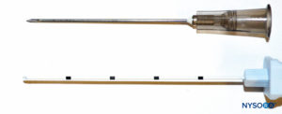
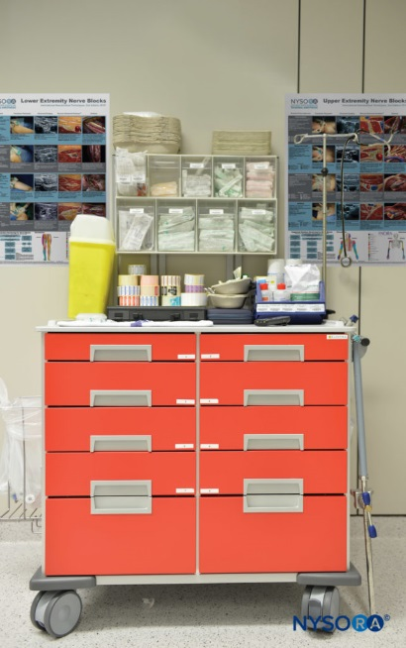
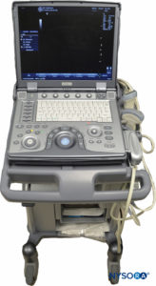
Nerve Block Supplies
Try to keep the setup simple.
Many centers utilize a block cart stocked with additional supplies and emergency equipment.
Ultrasound machine with linear transducer (6–14 MHz)
Nerve Stimulator – let’s look at it …
Needle for block
  usually short bevel to minimize possibility for new damage
  Gauge usually 20-22, Length most 50-100mm is adequate
  Needle markings helpful
  Echogenic gives greater visibility at different angles of insertion
Cleaning Agent

Slide 38
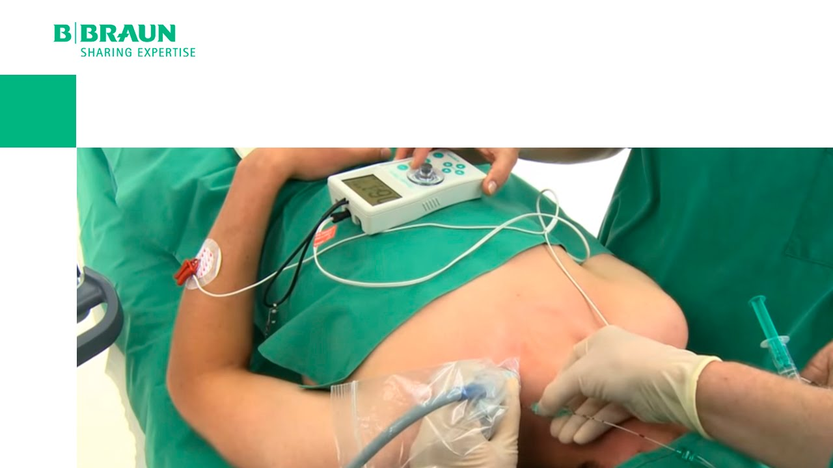
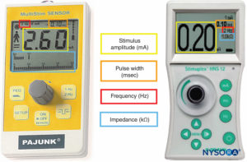
Nerve Stimulators
Most new stimulators can change the frequency at which the electrical pulse is delivered.
The optimal frequency of the pulse is between 0.5 and 4 Hz.
Most users select a frequency of 2 Hz.
When using a lower frequency, such as 1 Hz (one stimulus per second), the needle must be advanced slowly to avoid missing the nerve between stimulations.
Short pulse widths (ex. 0.04 ms) are a better indicator of the distance between the needle and the nerve, based on changes in current. In contrast, with long pulse widths (ex. 1 ms).
Stimulus Amplitude – good for injection 0.3-0.5
<0.2 Associated with intraneural position
Some start with higher amplitude and then turn down.

Slide 39
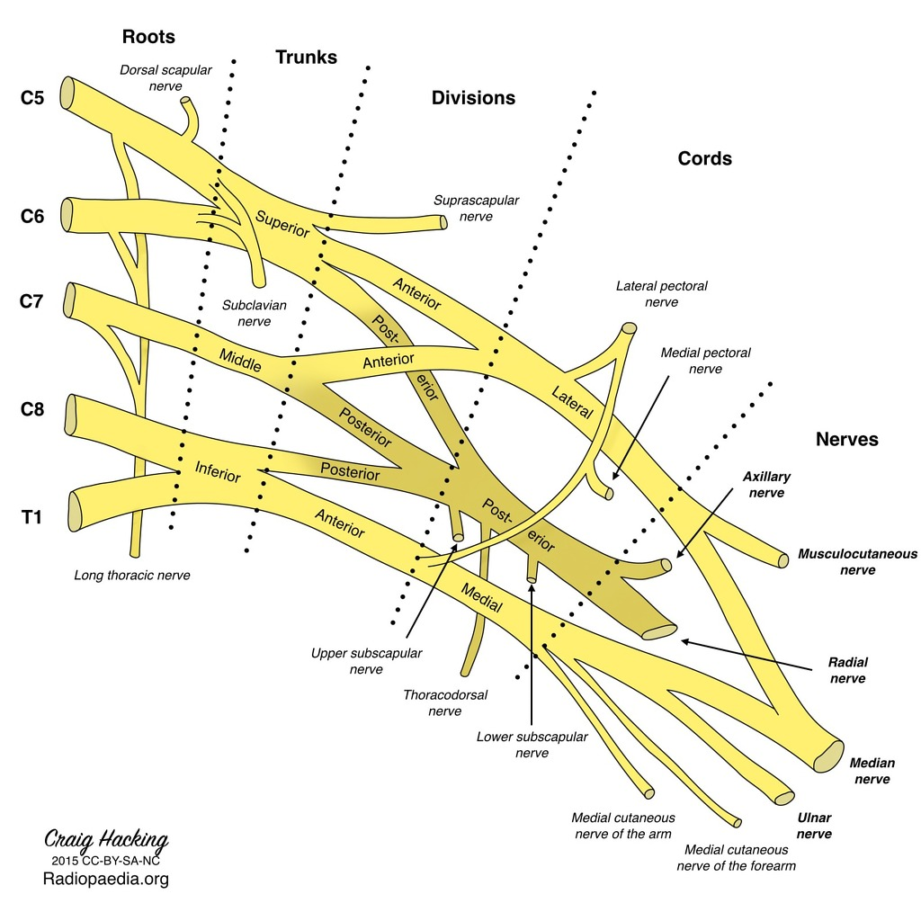
Upper Extremity Nerve Blocks
Various Approaches are available, and the operators approach may vary based on surgery, anatomy and skillset.
  Interscalene
  Supraclavicular
  Infraclavicular
  Axillary
  Branch Nerves

Slide 40
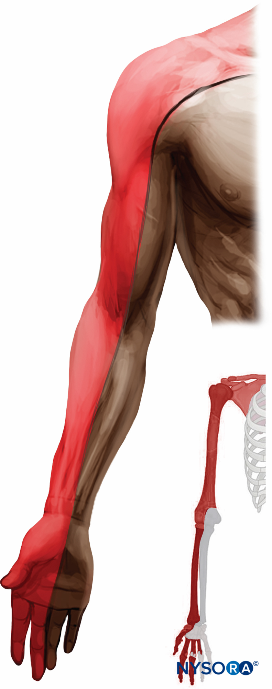
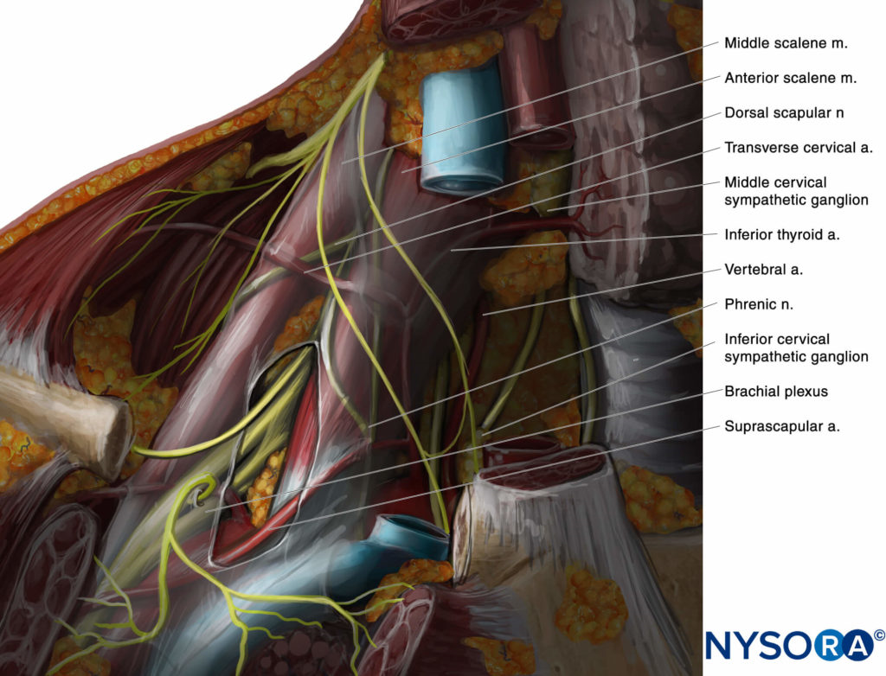
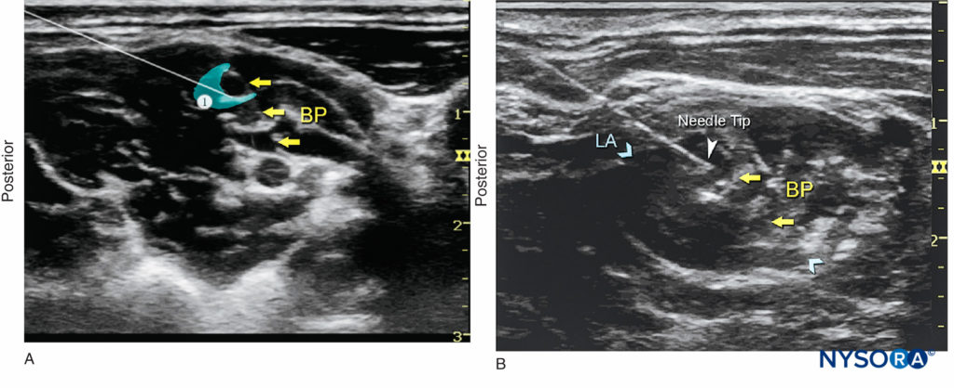
Interscalene Nerve Block
Indications: Shoulder and upper arm surgery, surgery of the clavicle (combined with cervical plexus block)
Transducer position: Transverse on the neck, 3–4 cm superior to the clavicle, over the external jugular vein Goal: Local anesthetic spread around superior and middle trunks of brachial plexus, between the anterior and middle scalene muscles Local anesthetic: 7–15 mL
Side effects/Complications
Diaphragmatic hemiparesis from ipsilateral phrenic nerve block
  (100% incidence, 25% reduction in pulmonary function)
Pneumothorax
Blockade of Vagus, recurrent laryngeal, and cervical sympathetic nerves (Horner's syndrome)
Epidural or subarachnoid injection
Vertebral artery injection
All Blocks
Bleeding
Infection
Allergic or adverse reaction to medication
Permanent neurologic injury (incidence 1:10,000)

Slide 41
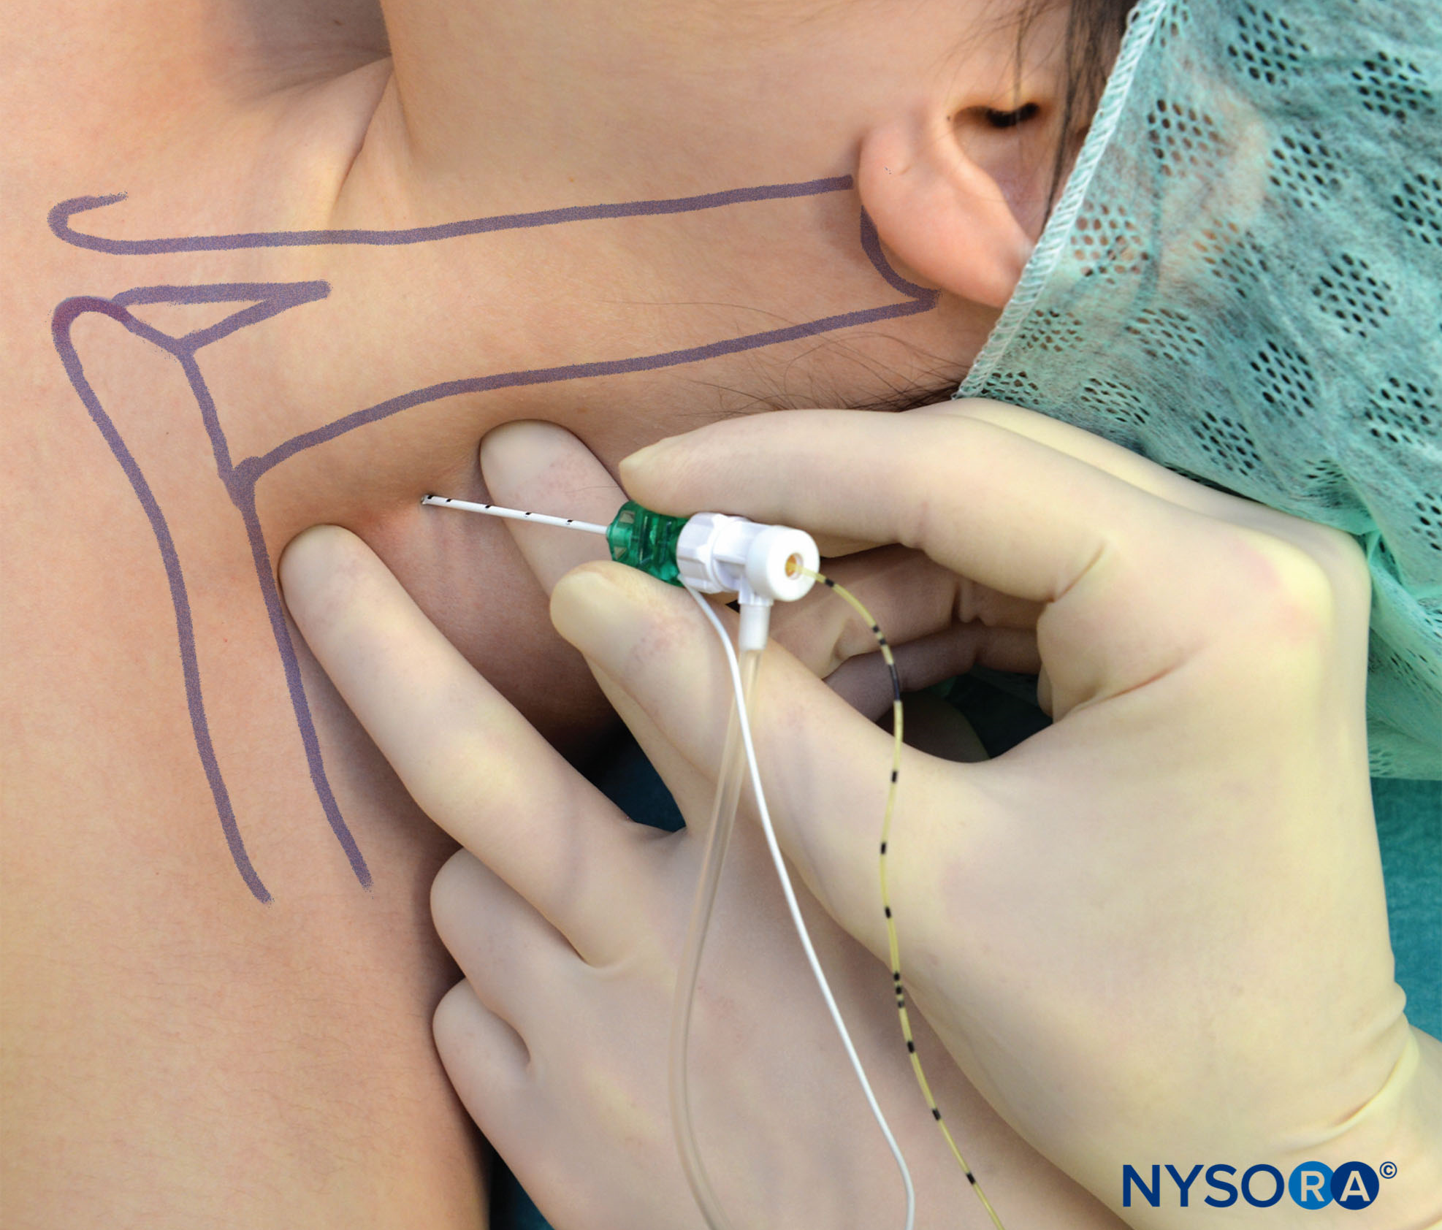
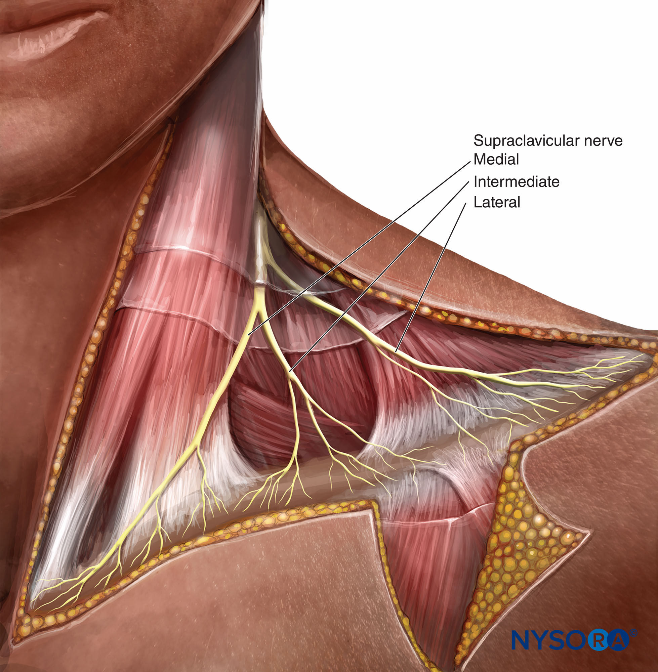
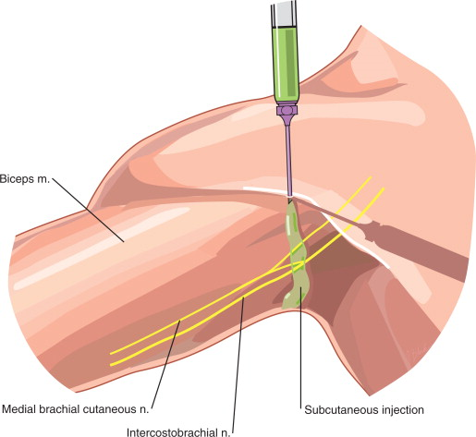
Shoulder Surgery
Arthroscopic: Nerves of importance to anesthesia: supraclavicular, suprascapular, and axillary (radial) nerves.
Open: Knowledge of the surgical approach is important because surgery may also involve the territories of the median cutaneous, intercostobrachial, and the median antebrachial cutaneous nerves.
Up to 70% of patients report severe pain on movement after open major shoulder surgery, which is more than after hysterectomy (60%), gastrectomy, or thoracotomy (60%).
Major shoulder surgery entails massive nociceptive input from the richly innervated joint and periarticular tissues, which produce continuous deep somatic pain and bouts of reflex spasm of muscles.
Periarticular structures exhibit not only C afferents, but also A alpha and A delta afferents, the latter being poorly blocked by opioids, which explains the relative inefficacy of opioids to control this type of postoperative pain.

Slide 42
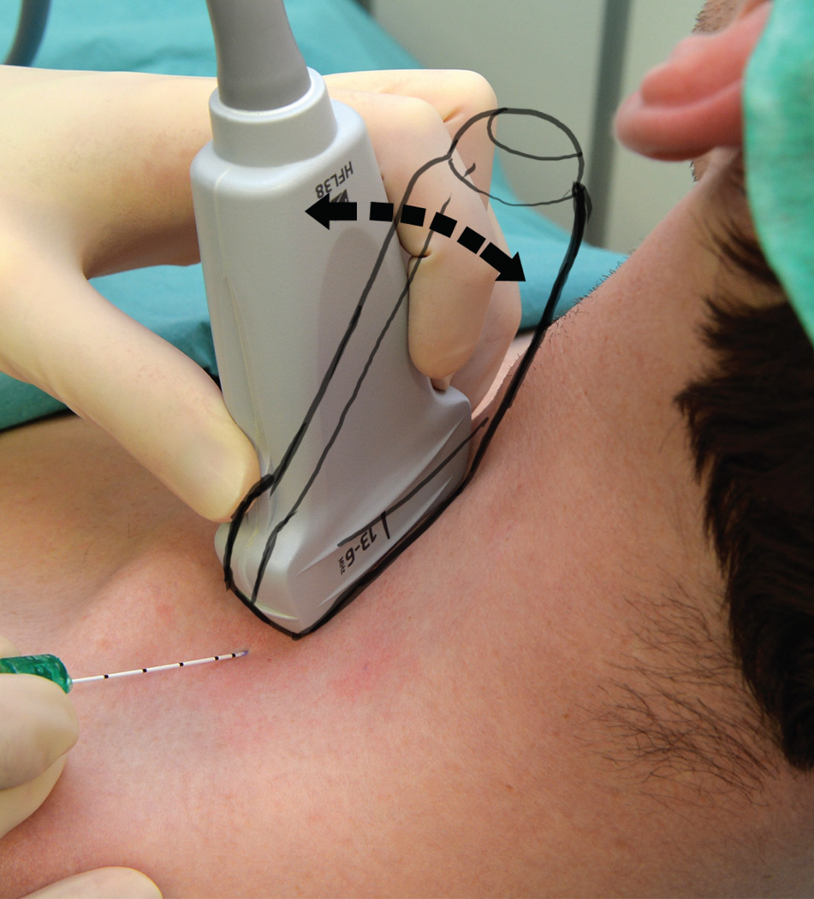
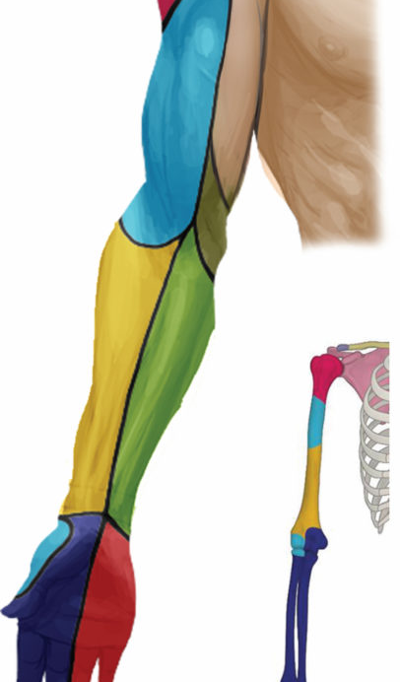
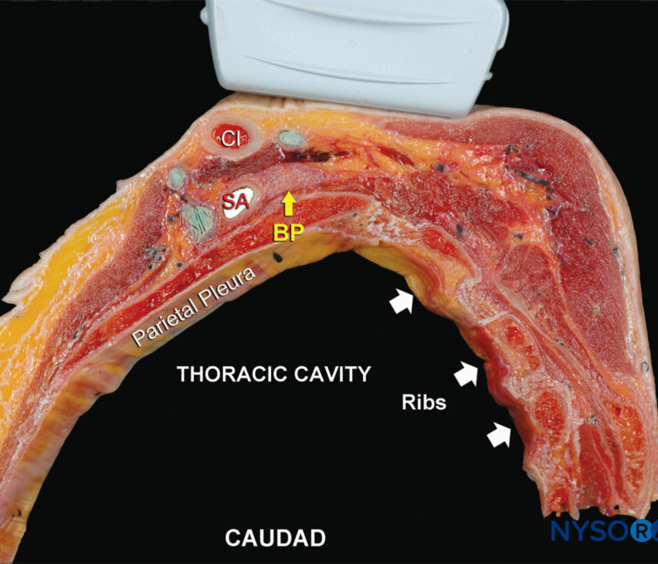
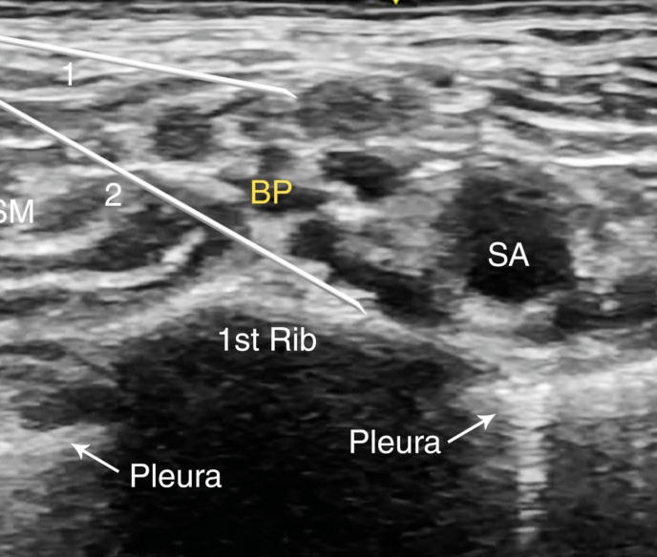
Supraclavicular Brachial Plexus Nerve Block
The transducer often is tilted slightly inferiorly.
  see the subclavian artery in the transverse view and the brachial plexus just superficial and posterior the artery.
needle within the brachial plexus sheath posterior to the subclavian artery and inject local anesthetic to surround the trunks and divisions of the brachial plexus at this level.
The risk of phrenic nerve palsy is lower than with the interscalene block but cannot be reliably avoided.
  Therefore, in patients who cannot tolerate a 27–30% decrease in respiratory function with phrenic blockade, an axillary or infraclavicular block is a better choice of anesthesia for upper extremity surgery.

Slide 43
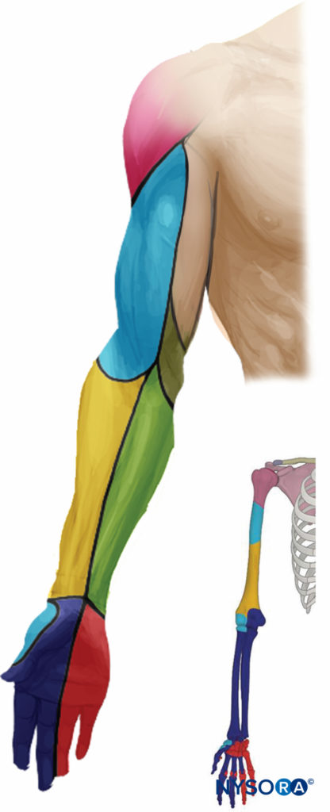
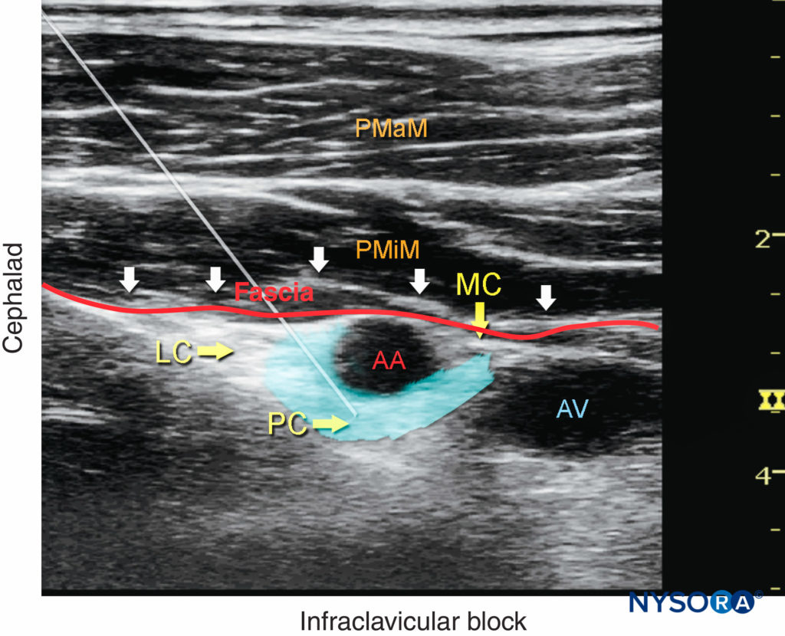
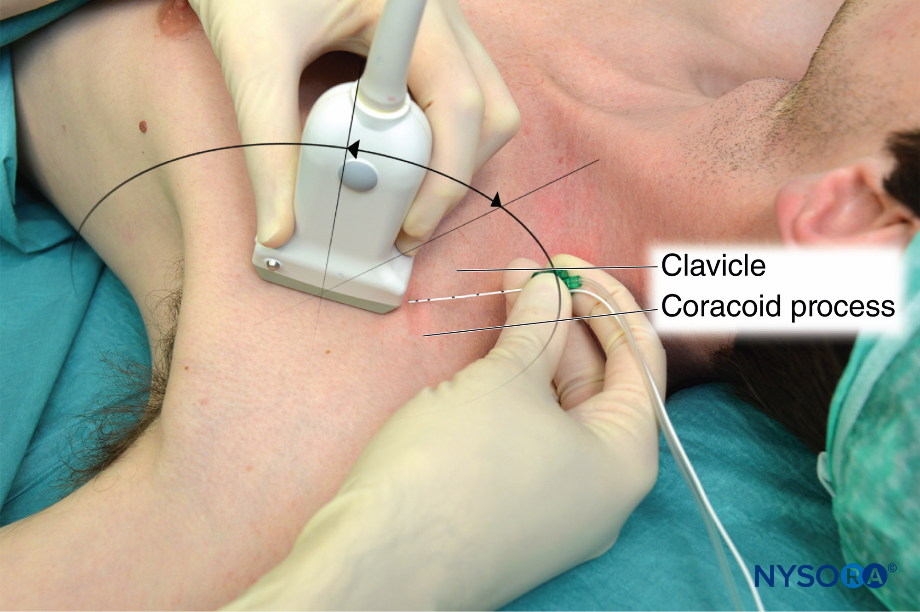
Infraclavicular Brachial Plexus Nerve Block
Indications: arm, elbow, forearm, and hand surgery
Transducer position: approximately parasagittal, just medial to the coracoid process, inferior to the clavicle
Goal: local anesthetic spread around axillary artery

Slide 44
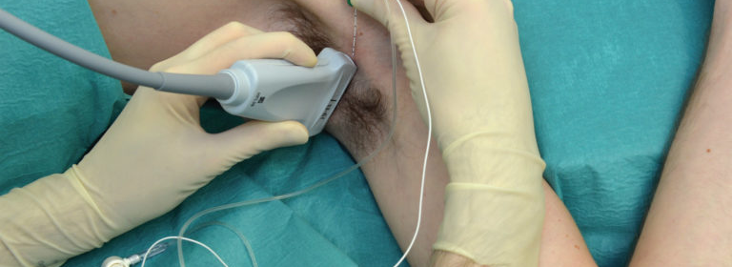
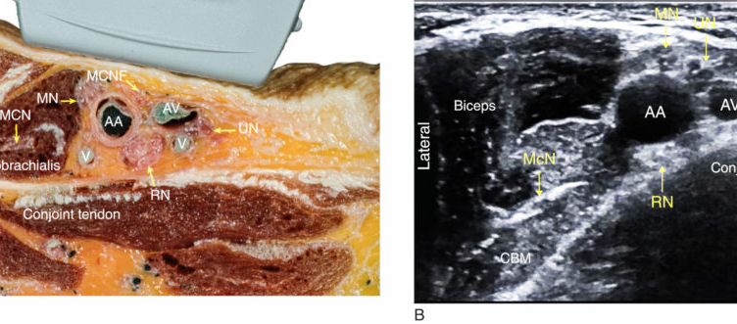
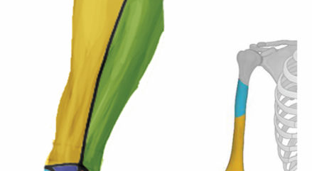
Axillary Nerve Block
Indications: elbow, forearm, and hand surgery
Transducer position: short axis to arm, just distal to the pectoralis major insertion
Goal: local anesthetic spread around axillary artery
Including the musculocutaneous nerve
Results in anesthesia of the upper limb from the mid-arm down to and including the hand.
Importantly, the block lends its name from the approach and not from the axillary nerve, which itself is not blocked because it departs from the posterior cord more proximally in the axilla.

Slide 45
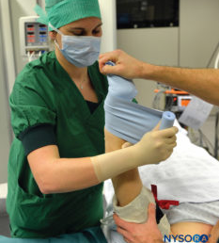
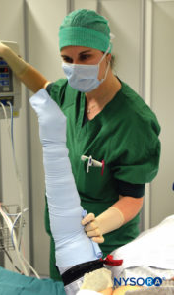
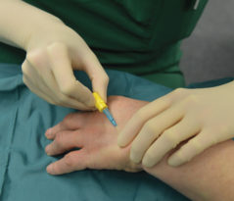
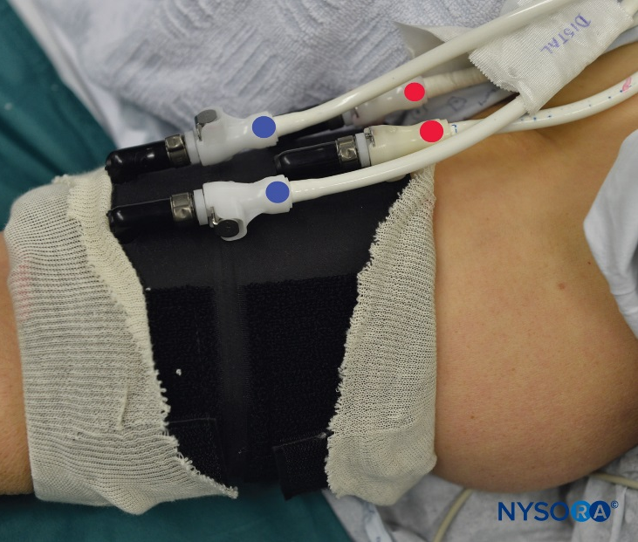
IV Regional Anesthesia
The Bier Block
Performed most commonly with lidocaine 0.5%–1%
Appropriate for surgery and manipulation of the extremities requiring anesthesia of up to 1 hour’s duration.
It is most suited for peripheral, soft tissue operations such as ganglionectomy, carpal tunnel release, Dupuytren’s contracture surgery, or reduction of fractures.
The only absolute contraindication to IVRA is patient refusal.
Relative contraindications include the following:
  Crush injuries of an extremity
  Inability to locate peripheral veins
  Local skin infections
  Cellulitis
  Compound fractures
  Patients with convincing history of allergy to local anesthetics
  Patients with severe vascular injuries to the extremity
  Preexisting vascular arteriovenous shunts and patients in whom a tourniquet is unsuitable (ex. patients with severe peripheral vascular disease)
  Sickle cell disease
  Surgery planed for >1 hour are typically not good indication for IV regional anesthesia due to occurrence of Tourniquet pain.

Slide 46
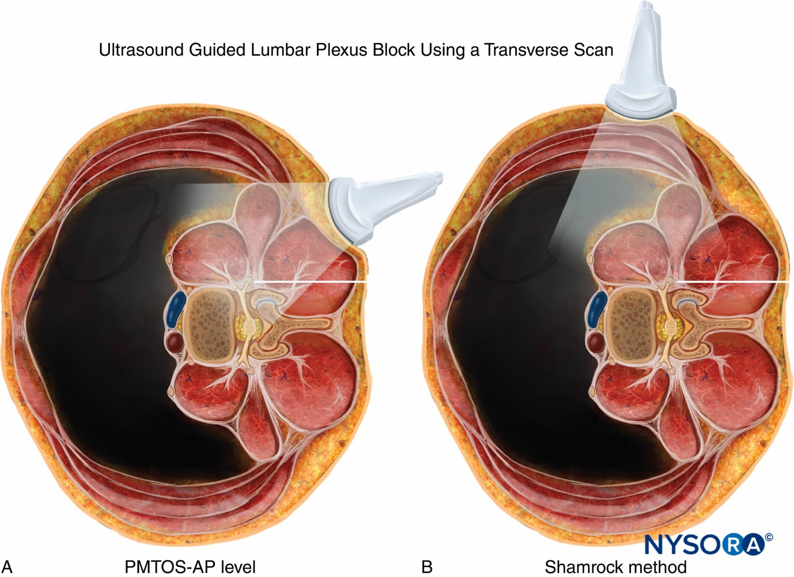
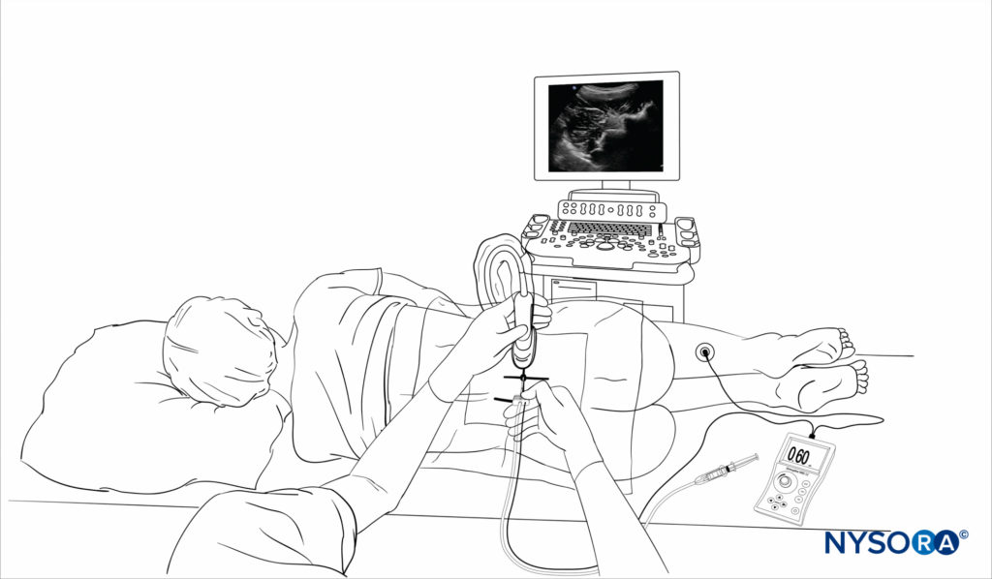
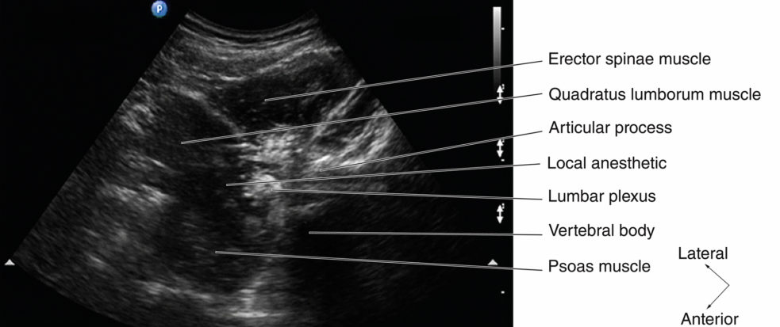
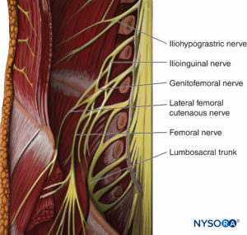
Lumbar Plexus Block
Produces anesthesia of the major components of the lumbar plexus: the femoral nerve (FN), lateral femoral cutaneous nerve (LFCN), and the obturator nerve (OBN).
Used as a sole technique or in combination with a sciatic nerve block for anesthesia or analgesia in patients having hip or lower extremity surgery.
It is also referred to as psoas compartment block (PCB) or posterior lumbar plexus block (PLB).

Slide 47
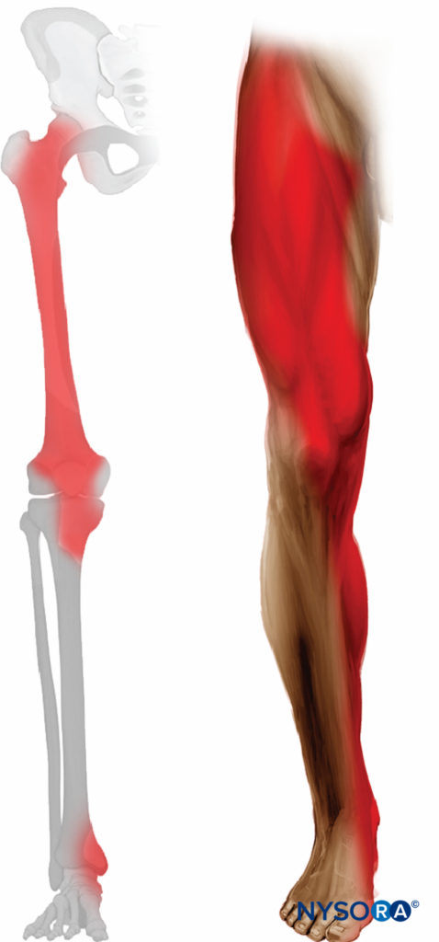
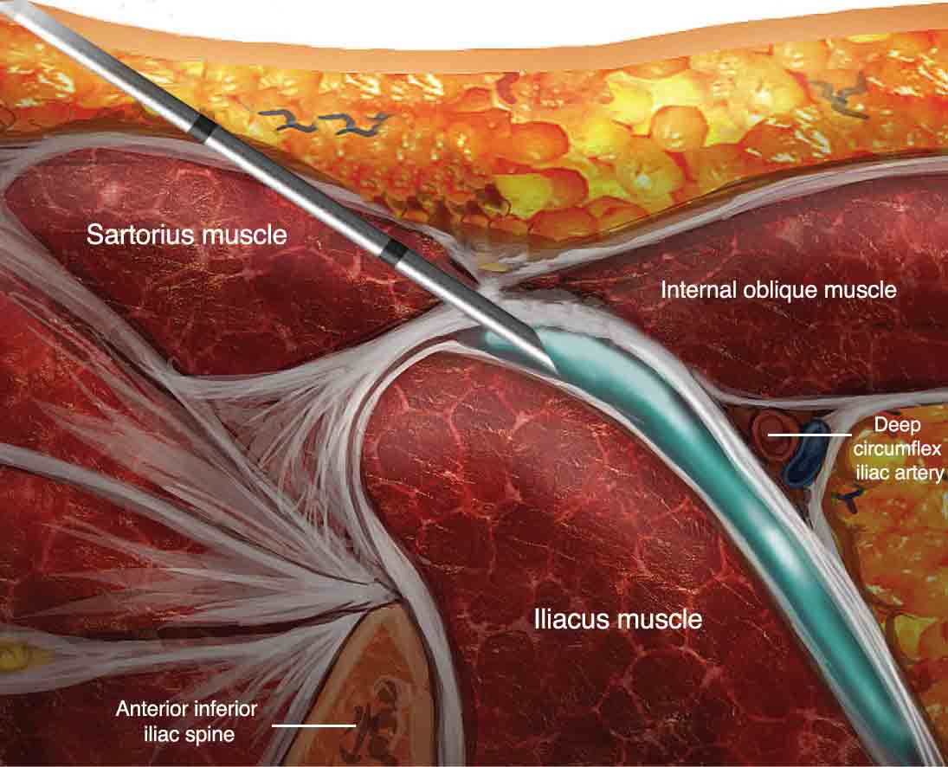
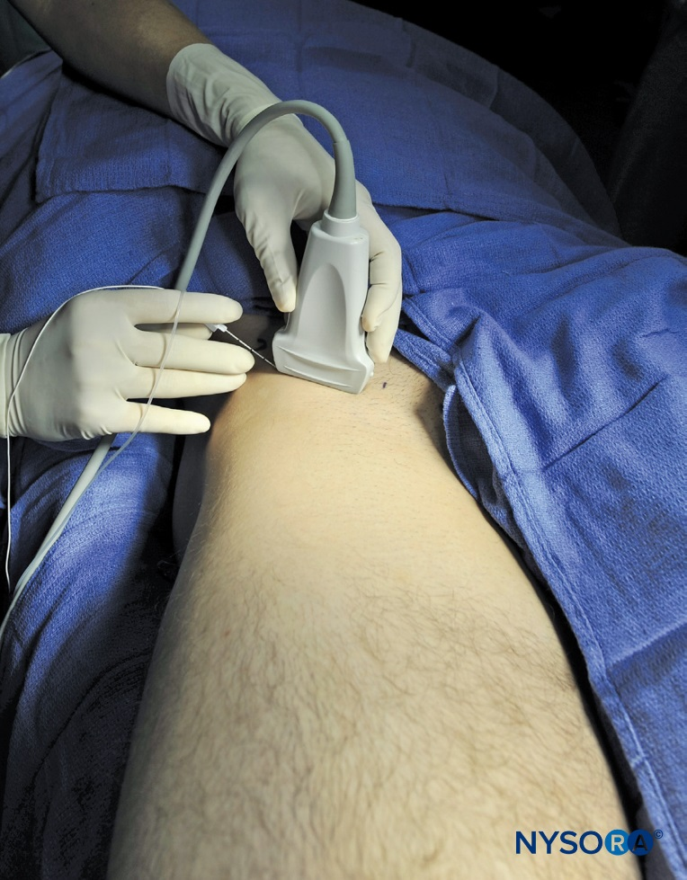
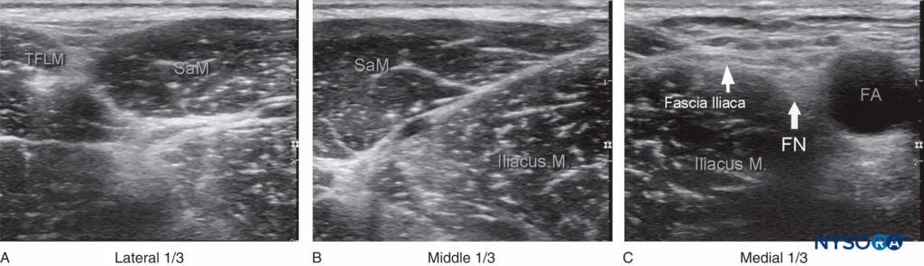
Fascia Iliaca Nerve Block
Indications: Analgesia for the anterior thigh, following hip and knee procedures
Transducer position: Transverse, close to the femoral crease and lateral to the femoral artery
Goal: A medial-lateral spread of local anesthetic underneath the fascia iliaca
Local anesthetic: 20–40 mL of dilute local anesthetic (ex. 0.2% ropivacaine)
The transducer can be placed anywhere between the level of the femoral crease and inguinal ligament.

Slide 48
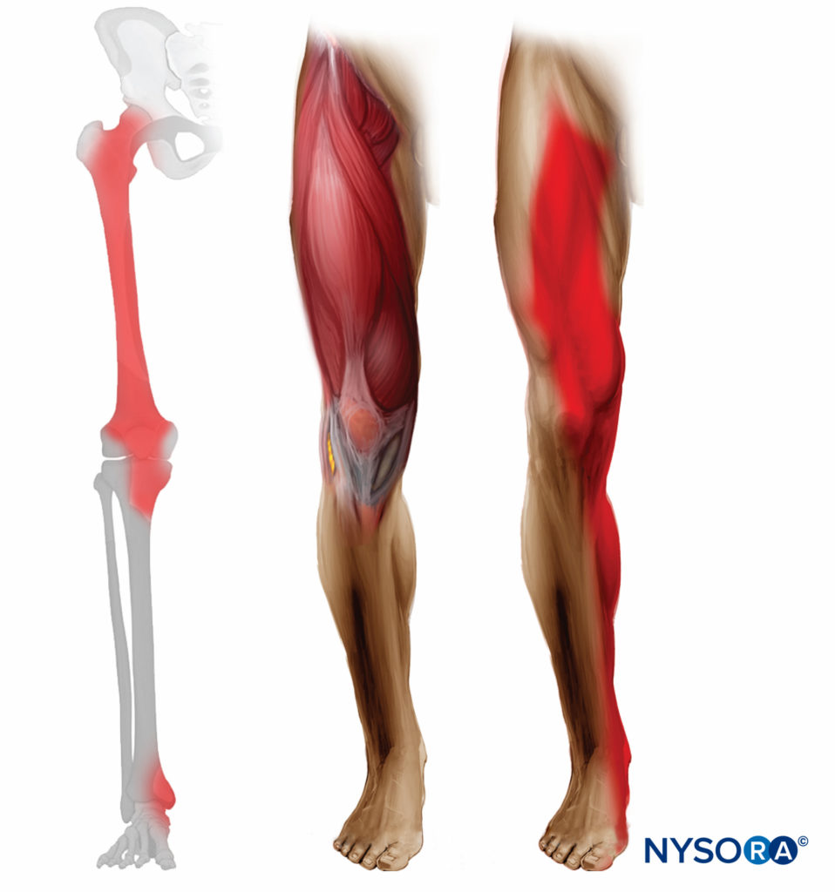
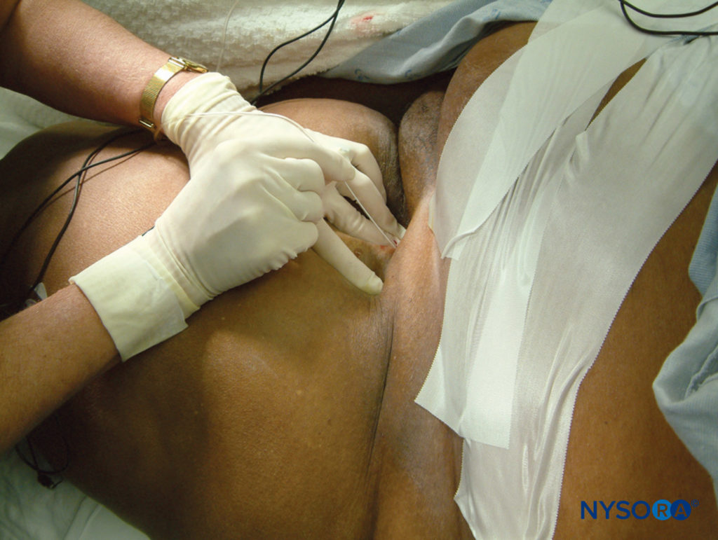


Femoral Nerve Block
Indications: Femur, patella, quadriceps tendon, and knee surgery; analgesia for hip fracture
Transducer position: Transverse, femoral crease
Goal: Local anesthetic spread adjacent to the femoral nerve

Slide 49




Saphenous Nerve Block
Indications: saphenous vein stripping or harvesting; supplementation for medial foot/ankle surgery in combination with a sciatic nerve block, and analgesia for knee surgery in combination with multimodal analgesia.
Approaches: Multiple different levels and approaches used.

Slide 50



Popliteal Sciatic Nerve Block
Results in anesthesia of the lower limb below the knee (both motor and sensory) with the exception of the medial leg and foot, which is the territory of the saphenous nerve.
The motor fibers to the hamstring muscles are spared; however, fibers to the posterior aspect of the knee joint are blocked.
Important to educate patients about a numb limb.
Remind patients that falls are likely if they are to apply weight to a blocked limb.

Slide 51



Sciatic Nerve Block
Indications: foot and ankle surgery, below-knee amputation, analgesia following knee surgery involving the posterior compartment.
Transducer position:
  Anterior approach: transverse on the proximal medial thigh
  Transgluteal approach: transverse on the posterior buttock, between the ischial tuberosity and greater trochanter
  Subgluteal approach: transverse on the gluteal crease

Slide 52


TAP Blocks
Transverse Abdominis Plane Block

Slide 53
Benefits of Regional Anesthesia
Better Pain control (but watch out for crush/high speed injuries)
Reduction in respiratory complications
Faster return of GI function
Less PONV
Some studies show less morbidity and mortality
Less chronic pain
Improved tissue oxygenation

Slide 54
Conclusions
Local anesthetics are important medications with various applications.
Each local has it’s own unique properties, which effect onset time and duration.
Being prepared for adverse reactions is key.
Blocks frequently improve outcomes and patient satisfaction.
Knowledge of anatomy and relationship to procedures is paramount.
Ultrasound has improved block efficacy and safety.

