Slide 1


CMS Changes for 2016/2017 That Affect You
Presented by Cathy Montgomery, RN, CASC
April 22, 2017

Slide 2
Recent Developments
CMS - Emergency Preparedness Plan
Office of Civil Rights – Non Discrimination
ADA – Service Animals
Quality Reporting – 2017 to do list

Slide 3
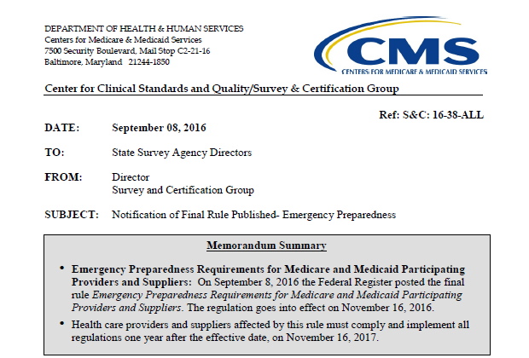
Emergency Preparedness Plan
Effective Date
11/16/16
100%
Compliance
by 11/16/17

Slide 4
Emergency Preparedness Plan
Federal Register Vol. 81 No. 180
ASC information starts at page 39 – 43 section 1832 (a) (2)(F)(i) and 42 CFR 416.2 and 416.40- 416.52.

Slide 5

Emergency Preparedness Plan
Accepted
Written Emergency Plan
Risk Assessment - Facility & Community
All Hazards Approach

Slide 6
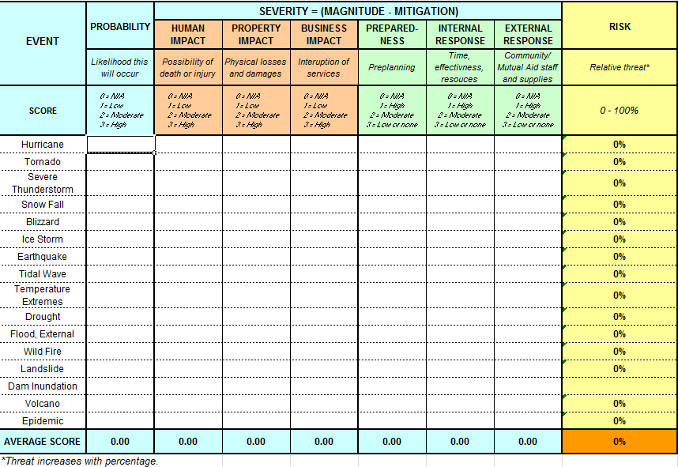
Emergency Preparedness Plan
Accepted

Slide 7
ALL HAZARDS APPROACH
Flexible structure for response to a variety of emergencies
Clear delineation of staff roles and responsibilities
Predictable chain of command
Accountability for staff involved
Prioritized response checklists
Use of common terminology to reduce miscommunication
Ability to be integrated into a community-wide plan

Slide 8
Emergency Preparedness Plan
Accepted
Coordination efforts
Tracking patients during emergencies
Contact information
Communication plan re Pt. information
Community disaster drills if available
Facility table top drills acceptable

Slide 9

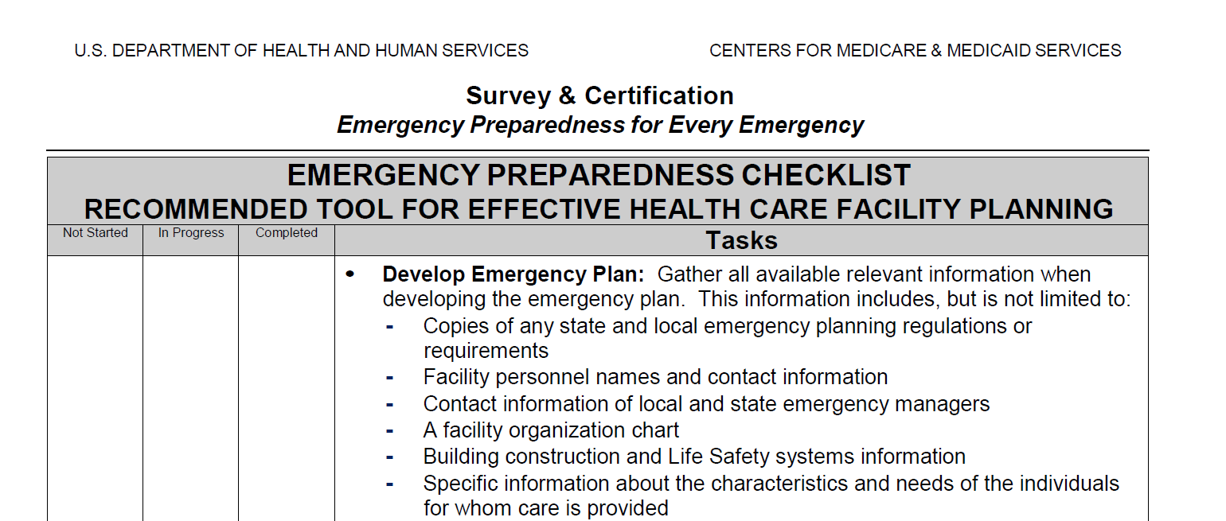
Emergency Preparedness Plan
Rejected

Slide 10
Emergency Preparedness Plan
Rejected
Subsistence needs
Transfer to alternate ASC’s
EHR
Community disaster drills

Slide 11
Office of Civil Rights
Non Discrimination
Section 1557 to be exact!
Section 1557 is the nondiscrimination law in the Affordable Care Act.
Prohibits discrimination on the basis of race, color, national origin, sex, age, disability.

Slide 12
Office of Civil Rights
Non Discrimination
First federal civil rights law to broadly prohibit sex discrimination in health programs and activities.
Sex discrimination includes, but is not limited to….based on an individuals sex, including pregnancy, related medial conditions, termination of pregnancy, gender identity and sex stereotypes.

Slide 13
Office of Civil Rights
Non Discrimination
Who does this apply to?
Any program that receives Federal financial assistance
Anyone who is administered by HHS
ALL of the employees of one of the above…..

Slide 14
Office of Civil Rights
Non Discrimination
Communication Requirements
YOU MUST OFFER
Non English speaking persons
Limited English proficiency (LEP)
Services to the hearing impaired
* Rules apply to all individuals in the United States, whether legally or not.

Slide 15
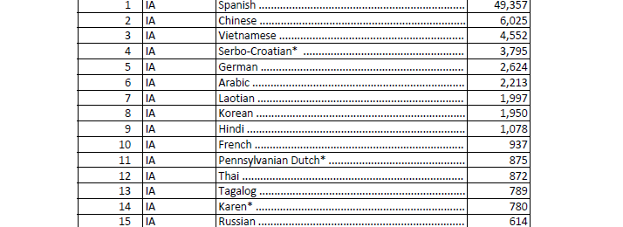
LEP TAG LINE BY STATE

Slide 16
LEP TAG LINE STEPS
http://www.hhs.gov/civil-rights/for-individuals/section-1557/translated-resources/index.html
Español (Spanish)
Notice of Nondiscrimination. - PDF | .docx
Statement of Nondiscrimination. - PDF | .docx
Tagline. - PDF | .docx

Slide 17
LEP TAG LINE STEPS
ENGLISH
SURGERY CENTER XYZ complies with applicable Federal civil rights laws and does not discriminate on the basis of race, color, national origin, age, disability, or sex.
Attention: If you speak (Limited English), language assistance services, free of charge, are available to you.
SPANISH
SURGERY CENTER XYZ cumple con las leyes federales de derechos civiles aplicables y no discrimina por motivos de raza, color, nacionalidad, edad, discapacidad o sexo.
ATENCIÓN: si habla español, tiene a su disposición servicios gratuitos de asistencia lingüística.

Slide 18
Office of Civil Rights
Non Discrimination
YOU MAY NOT:
Require an individual to provide his or her own interpreter
Rely on a minor child to interpret, except in a life threatening emergency where there is no qualified interpreter immediately available
Rely on interpreters that the individual prefers when there are competency, confidentiality or other concerns
Rely on unqualified bilingual or multilingual staff
Use low-quality video remote interpreting services

Slide 19
ADA – Service Animals

Slide 20
ADA – Service Animals
DEFINITION
Dogs individually trained to do work or perform tasks for an individual with a disability.
In addition to the provisions about service dogs, the Department’s revised ADA regulations have a new, separate provision about miniature horses that have been individually trained to do work or perform tasks for people with disabilities.

Slide 21
ADA – Service Animals
DEFINITION
Do work or perform tasks- animal trained to take a specific action when needed to assist a person with a disability.
emotional support vs psychiatric service

Slide 22
ADA – Service Animals
Professional training not required
Vest, ID badge, or harness not required
Certification not required
Registration not required
Specific breeds not required

Slide 23
ADA – Service Animals
2 questions you may ask, only these 2!
Is the dog a service animal required because of a disability?
What work or task has the dog been trained to perform?

Slide 24
ADA – Service Animals
2 Requirements
Must be under control
Must be housebroken
Miniature Horses: “Our facility is unable to accommodate miniature horses due to the size constraints of our floorplan and the general size of a miniature horse being up to 34 inches and 70 to 100 pounds.”

Slide 25
ASC Quality Reporting
ASC’s paid under Medicare Part B
240 Medicare claims per year
In operation four months prior to Jan. 1, 2016

Slide 26
ASC Quality Reporting
Section 1833(i)(7)(A) of the Act
states that the Secretary may provide that any ASC that does not submit quality measures
to the Secretary in accordance with paragraph (7) will incur a 2.0 percentage point
reduction to any annual increase provided under the revised ASC payment system for
such year.

Slide 27


3 Methods to Report
CMS-1500 form or associated electronic data set
www.qualitynet.org
www.cdc.gov/nhsn

Slide 28
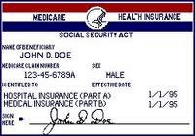
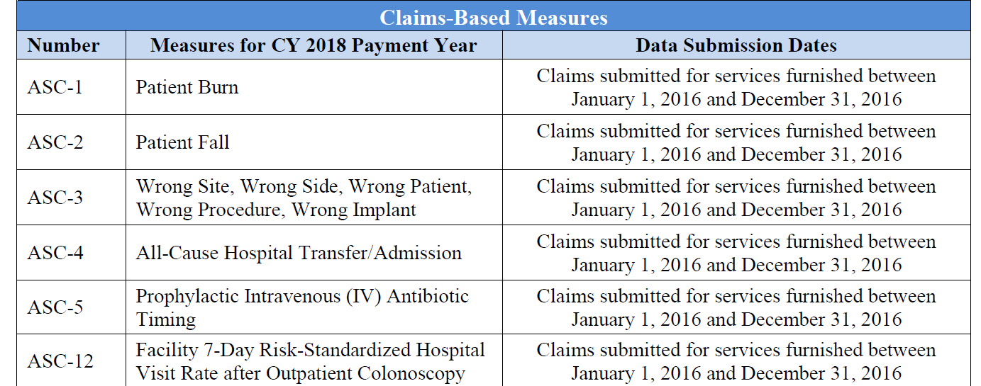


QUALITY REPORTING

Slide 29
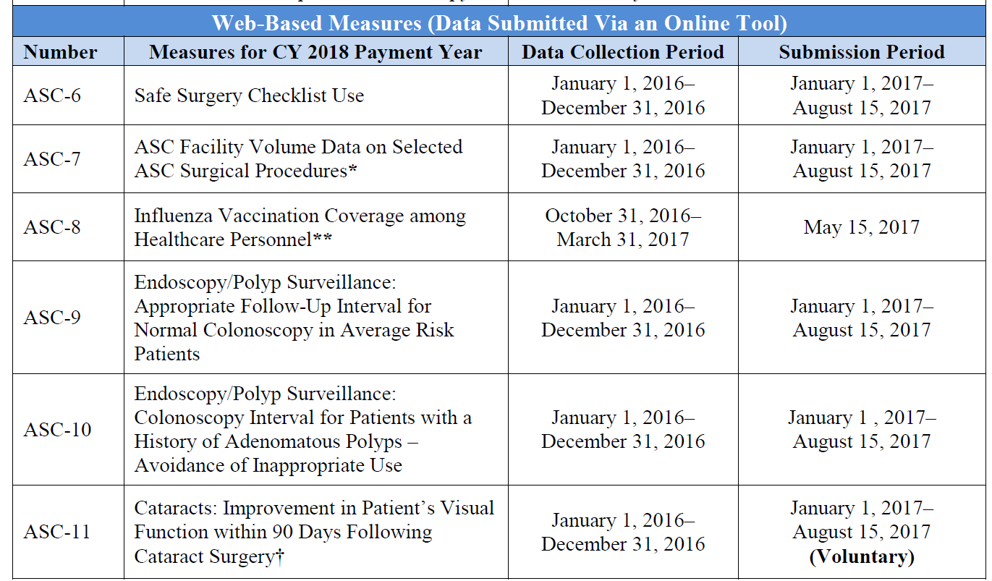
Quality Reporting

Slide 30
ASC Quality Collaboration
April 1st thru June 30, 2016
Patient Falls = 0.104 per 1000 admissions
Burns = 0.011 per 1000 admissions
Transfers = 1.008 per 1000
Wrongs = 0.027 per 1000 admissions
Antibiotics = 99% on time

Slide 31

Measures Submitted via www.cdc.gov/nhsn
ASC-8: Influenza Vaccination Coverage among Healthcare Personnel

Slide 32
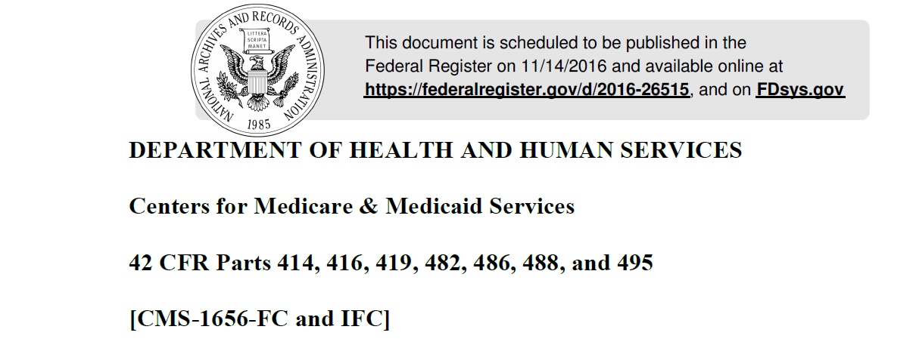
11/14/16
1378 pages
ASC Portion 972-1092

Slide 33
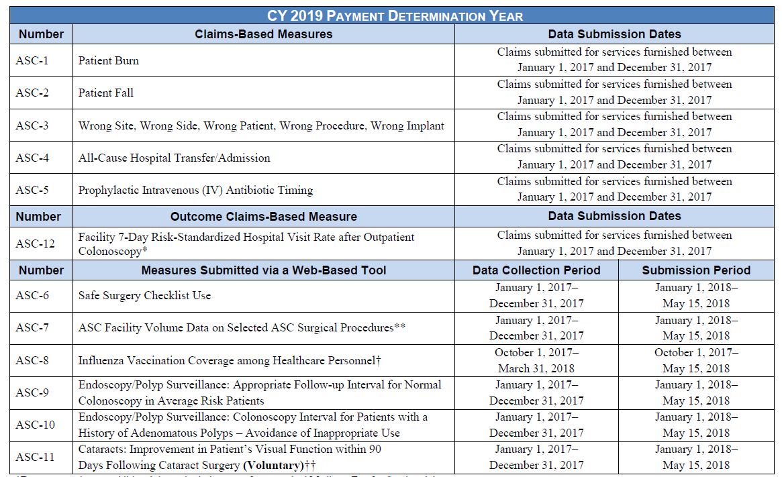

Slide 34
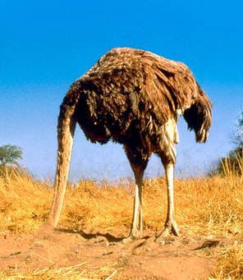
2017
You will follow business as usual for reporting.
Start to prepare for the changes you will need to put into effect 1/1/18

Slide 35
2018
ASC-13 Normothermia Outcome
ASC-14 Unplanned Anterior Vitrectomy
ASC- 15 a-e Patient Survey
2017 Plan ahead
2018 Submit your data Jan 1 thru May 15, 2019
2020 Payments effected

Slide 36

ASC -13
Numerator = # of patients > 96.8 degrees within 15 min of admit to PACU
Denominator = # of patients undergoing surgical procedure under general/epidural/spinal > 60 min.

Slide 37
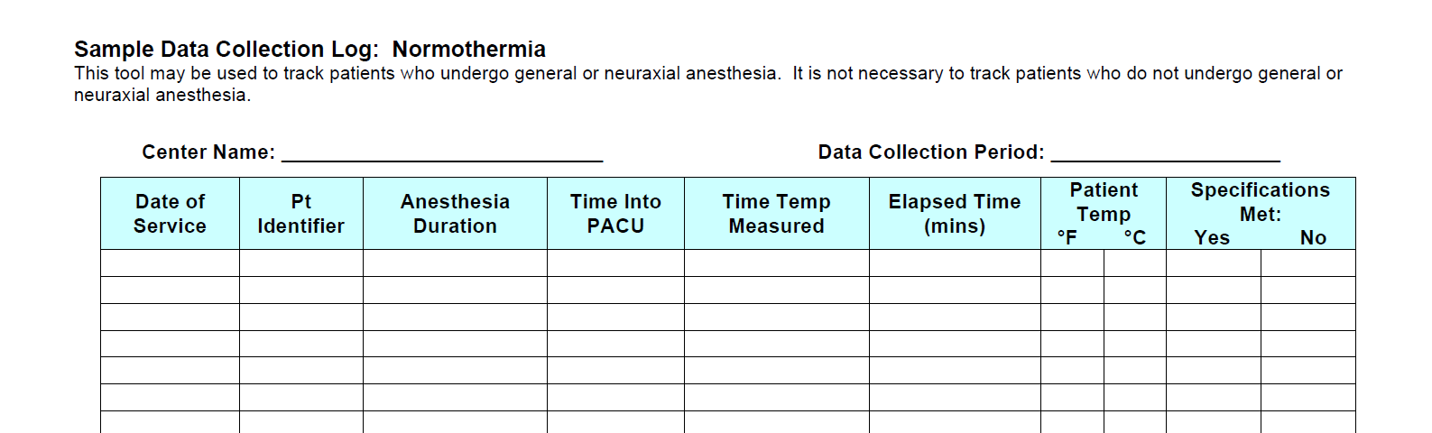
Collect Your Data

Slide 38
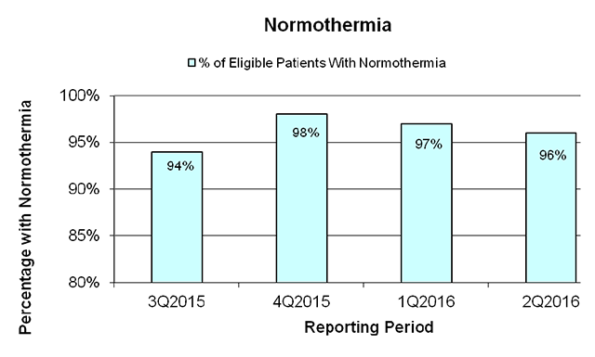
Current Statistics

Slide 39
ASC - 14
Numerator = # of all cataract patients having an unplanned vitrectomy.
Denominator = # of all patients undergoing cataract surgery.

Slide 40
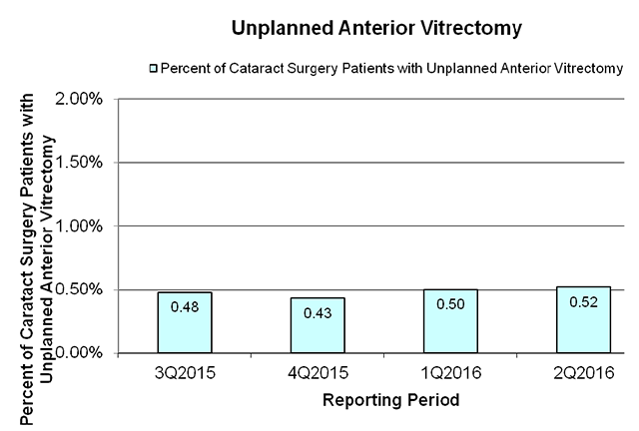
Current Statistics

Slide 41
ASC – 15 (a-e)
Consumer Assessment of
Healthcare Providers and Systems
Outpatient and Ambulatory
Surgery Survey
(OAS CAHPS®)
A patient experience of care survey about outpatient and ambulatory surgeries
and procedures

Slide 42
ASC – 15 (a-e)
CMS wants a standardized format
Formats are not patient centered
Empowers patients to be informed
Teaching moment for facilities
*Hospitals started this process in 2006 (HCAHPS)

Slide 43
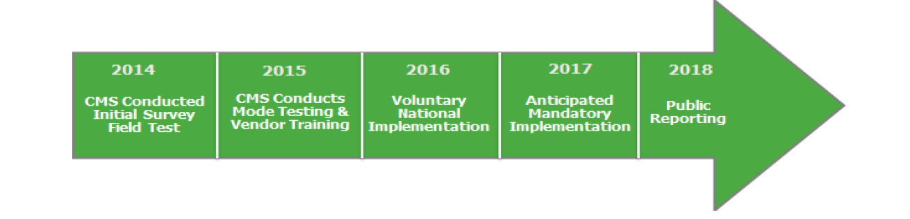
ASC – 15 (a-e)
37 Questions
2018
2020

Slide 44
ASC – 15 (a-e)
WHAT YOU MUST DO
Choose an approved vendor https://oascahps.org
Data will be collected monthly (300/yr.)
Vendor will report quarterly
You may add up to 15 questions of your own
Not penalized for your scores

Slide 45
ASC – 15 (a-e)
All payers
18 or older
______________________________________________
No NH patients
No hospice patients
No prisoners
Live outside of the US
Does not meet the CPT codes listed
Deceased

Slide 46
ASC – 15 (a-e)
Exception : < 60 patients in the calendar year before the data collection period
So CY 2017 for collection period 2018
Submit exception request on or before May 15 of 2018
If less than the 240 Medicare patients, then don’t worry

Slide 47
Questions
Preparation for surgery
Check-in process
Facility environment
Staff communication
Discharge
Recovery and outcomes
Overall experience

Slide 48
Trial Outcomes
37% mail response
34% telephone response
Mixed 50% response

Slide 49
Patient Eligibility Requirements
A procedure is OAS CAHPS-eligible if it has a G-Code of G0104, G0105, G0121 or G0260, or
A surgery, diagnostic procedure, or other type of procedure is OAS CAHPS-eligible if it has a CPT-4 code in the 10021– 69990 range, was performed in an outpatient surgery department or ambulatory surgery center, was not billed as Laboratory, Radiology, Physical Therapy, Respiratory Therapy, or Diagnostic studies and if it has no accompanying modifier of 73 or 74 (discontinued procedure),
Also note that a facility may assign more than one code to a surgery or procedure. The presence of one eligible G-code or CPT code is all that is needed to make it OAS CAHPS-eligible.
G Codes (HCPCS Level II) are alphanumeric medical procedure codes for temporary procedures and professional services. HCPCS Level II codes are maintained by CMS.
Current Procedural Terminology (CPT).
Modifiers 73 and 74 (discontinued procedure) indicate that a procedure or surgery did not take place. CPT-4 codes with Modifier 73 or 74 should be excluded.

Slide 50
Plan Ahead….But No Cheating
No communication with patients re survey
Do NOT give patients a copy
Do not use any survey phrases in marketing or promotional materials
Influence patient or families
Ask for high scores
Offer incentives
Help patients with their answers
Ask patients if they would like a survey

Slide 51
Please email your questions and comments to:
cathy@excellentiagroup.com
Excellentia Advisory Group, LLC
1-636-875-5088 ext. 102

