Slide 1
What is Your Surveyor Really Looking For?
Presented by Cathy Montgomery, RN, CASC

Slide 3
Where do you fit in?

Slide 4
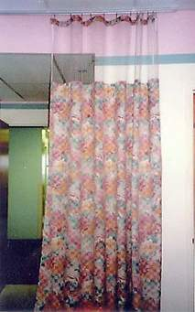
Patients Rights
Advanced Directive
Communication
Grievance
Privacy

Slide 5
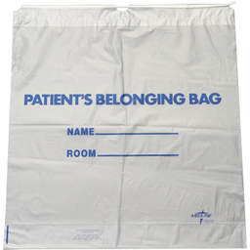
Patient Responsibility
Honesty
Respect
Personal belongings
Driver

Slide 6
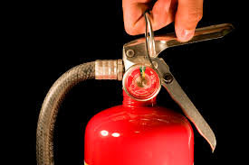
Environment
Emergency Equipment
Alarm pulls
Fire Extinguishers
Fire Drills
Disaster Drills

Slide 7
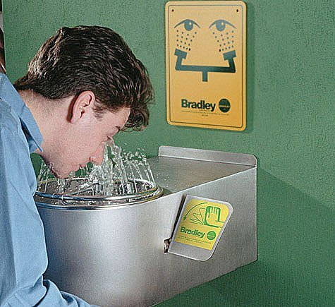
Environment
Emergency Equipment
Defibrillator / AED
Crash cart
Poison control
MH Association
Eye Wash Stations

Slide 8
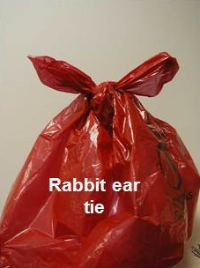
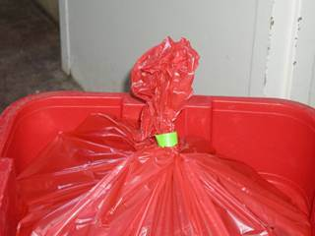
GOOD
BAD
BAD

Slide 9
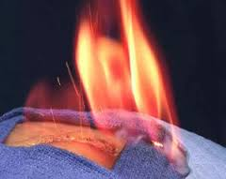
Surgical Services
Conscious sedation
Hospital Transfers
Fire Risks in the OR

Slide 11
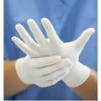
Infection Control/Safety
No patient care items under sinks
PPE
Hand hygiene

Slide 13
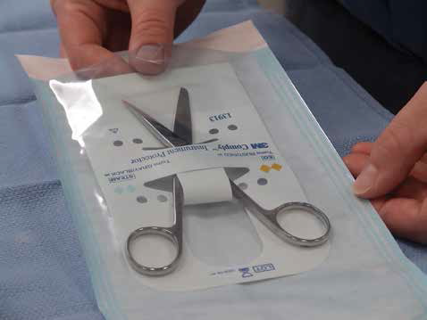

Slide 14
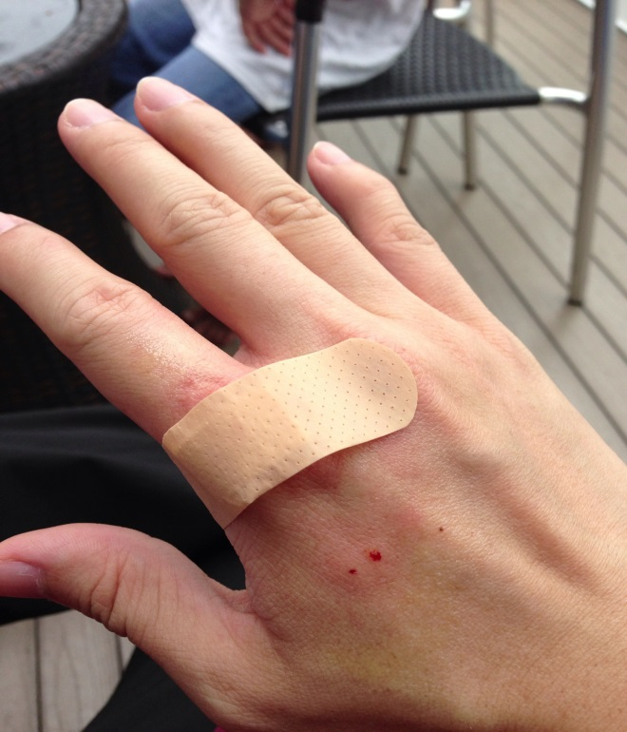
PPE
Staff
Protect them from patients and environment
Protect patients from them!

Slide 15
Safety

Slide 16
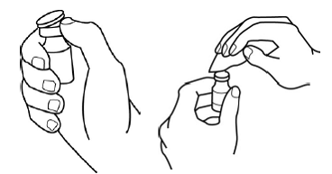
Pharmacy Services
Medication Safety
MDV - patient care areas
SDV – no preservatives!
Newly opened vials -
Expired meds – try red dot system

Slide 17
Not Safe for MH Susceptible Pts
Inhaled General Anesthetics
Desflurane
Enflurane
Ether
Halothane
Isoflurane
Methoxyflurane
Sevoflurane
Succinylcholine (warning)

Slide 18
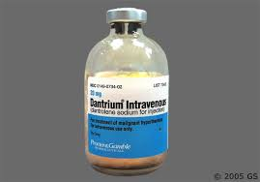
Dantrolene Rules
36 vials must be present
Each vial should be reconstituted with 60ml of sterile water for injection without a bacteriostatic agent
Shake until clear

Slide 19
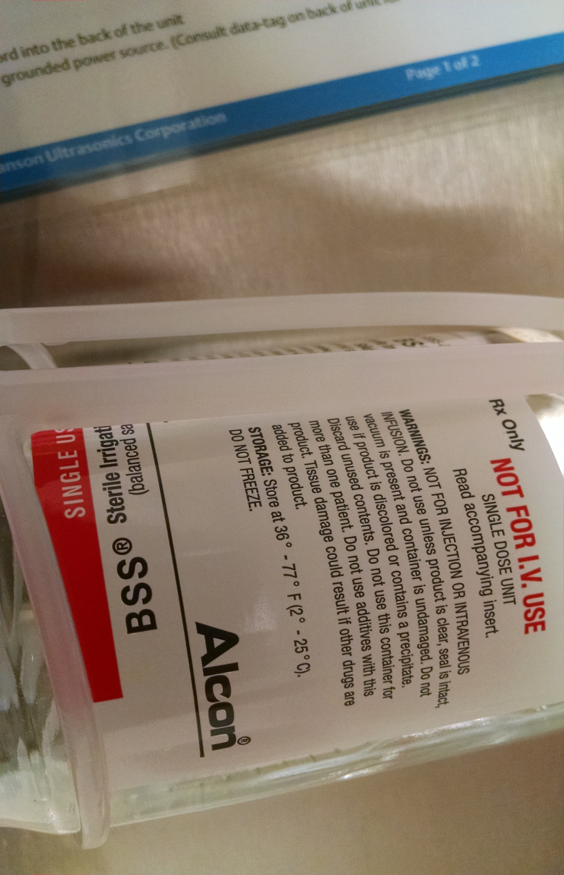
Medication Safety

Slide 20
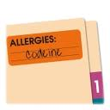
Medical Records
Advanced Directive
Allergies
Consents
Confidentiality

Slide 21
Patient Satisfaction Surveys
GREAT 5 | GOOD 4 | OK 3 | FAIR 2 | POOR 1

Slide 22
April 22, 2017
Please email your questions and comments to:
cathy@excellentiagroup.com
Excellentia Advisory Group, LLC
1-636-875-5088

